Slide 1
Doodle Jump
Stejara Dinulescu

Slide 2
Concept/Motivation
In a GAN that works with images, what is the relationship between input and output?
How do different inputs change the outputs?
More specifically, does the way in which the input was created affect the output (i.e. general trends, what is more visually interesting, etc.)?
How can I push the output so that it can stand alone as Art
Context/controversy about ownership + GANs
Can digital images produced by a machine be art?

Slide 3
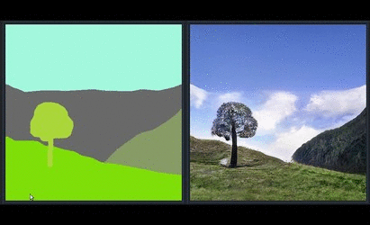
Initial motivating questions/issues
What GAN can I use that best allows me to explore my above questions?
How do I work with this GAN?
Pre-trained? Train my own? Make my own algorithm?
Chose pre-trained GAN, SPADE-COCO, in RunwayML
Takes abstract images and converts it to real-life objects
RunwayML allows for easy working with GANs
What should I give as input to get interesting output?

Slide 4
Process: Exploring Input -> Output and HCI
Relations between inputs and outputs are explorations of different pathways of human-computer interaction
Physical drawings (human -> computer)
Digital drawings
Using Notes application on my iPhone (human/computer -> computer)
Using Drawing Manager (human -> computer -> human /computer -> computer)
Drawing Manager Library made by Jennifer Jacobs
Extensions of Drawing Manager Library made by Stejara
Plotter drawings
Digital drawings (human/computer -> machine -> computer)
Digital code in Processing (human -> computer -> computer)
Digital code in Processing (human -> computer -> computer)
Later question: how does pre-processing of an image affect an output (addition of another “computer” pathway)?

Slide 5
Hand-drawn inputs

Slide 6
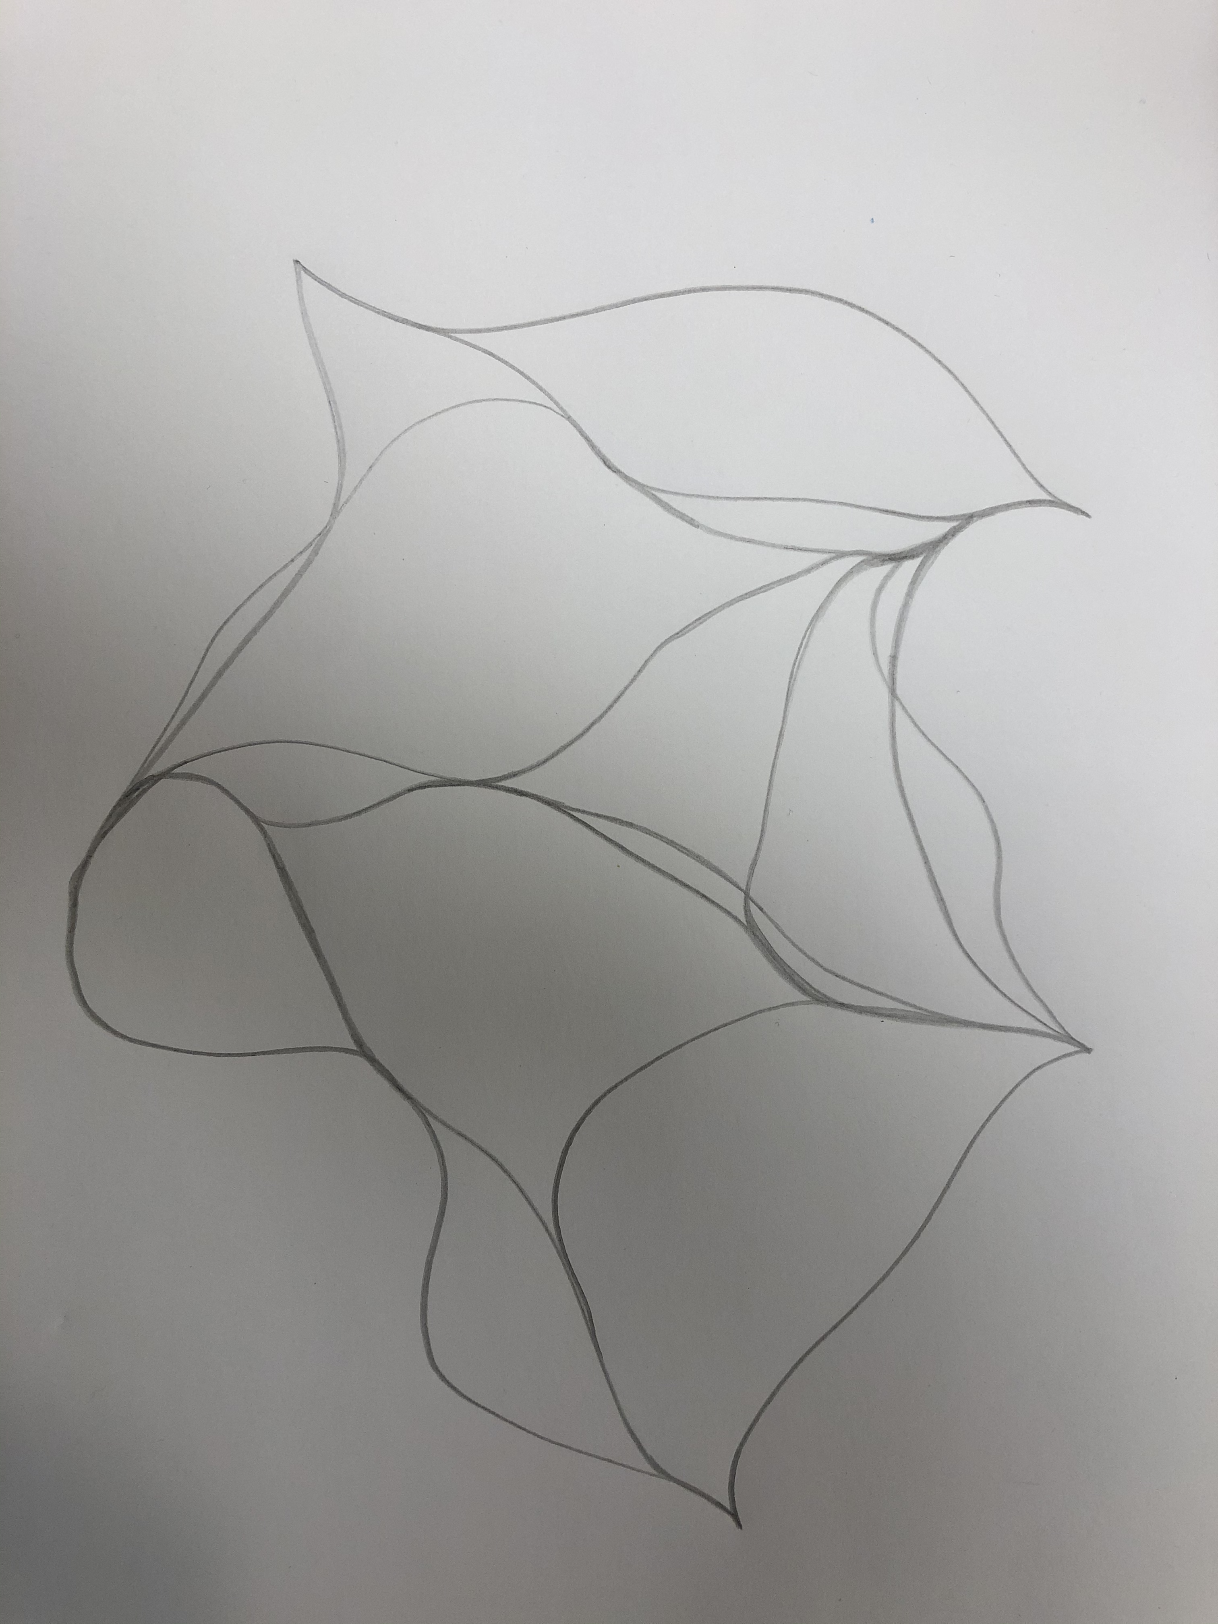
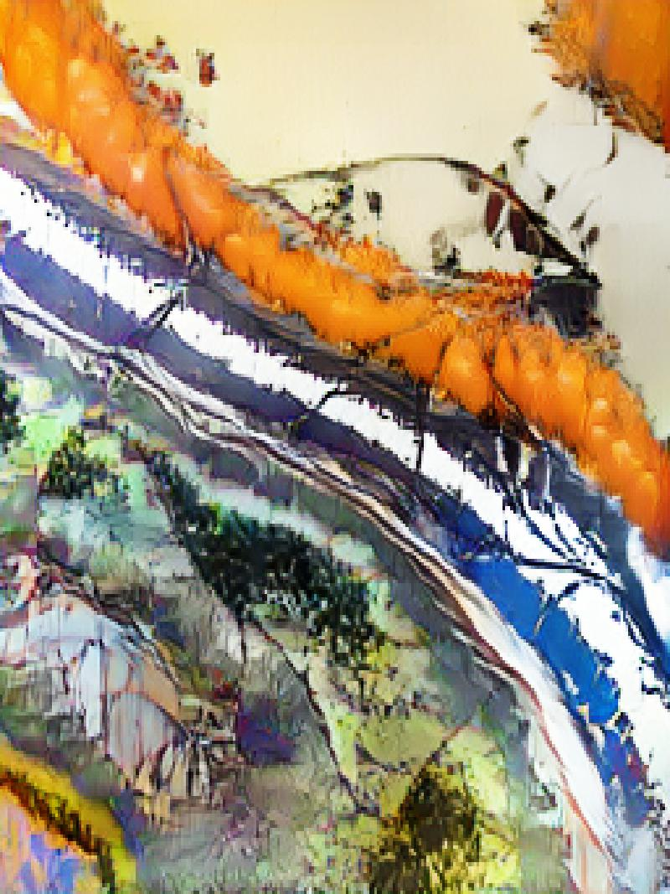
No pre-processing

Slide 7
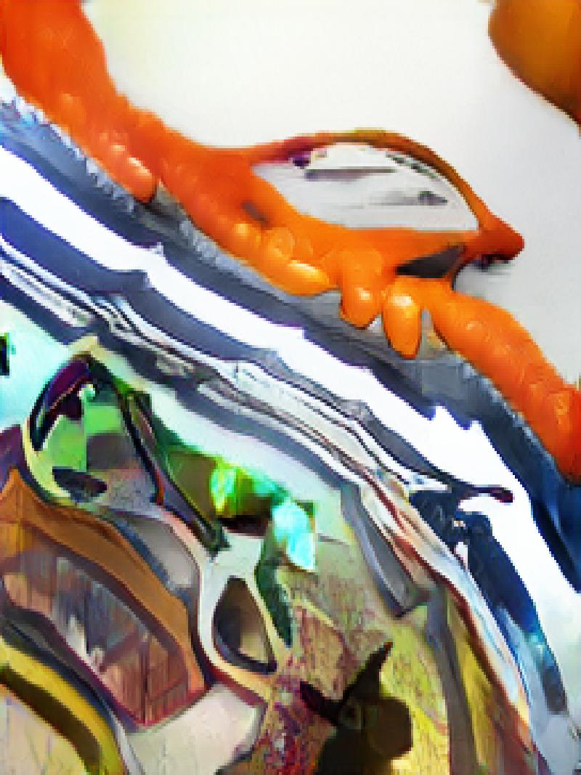
Gaussian blur pre-processing

Slide 8
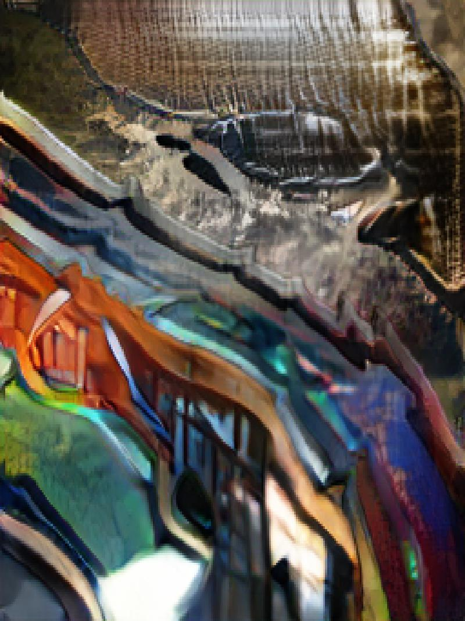
Invert + gaussian blur pre-processing

Slide 9
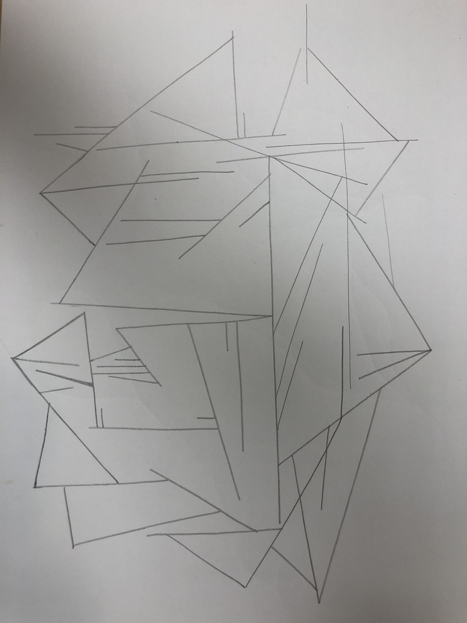
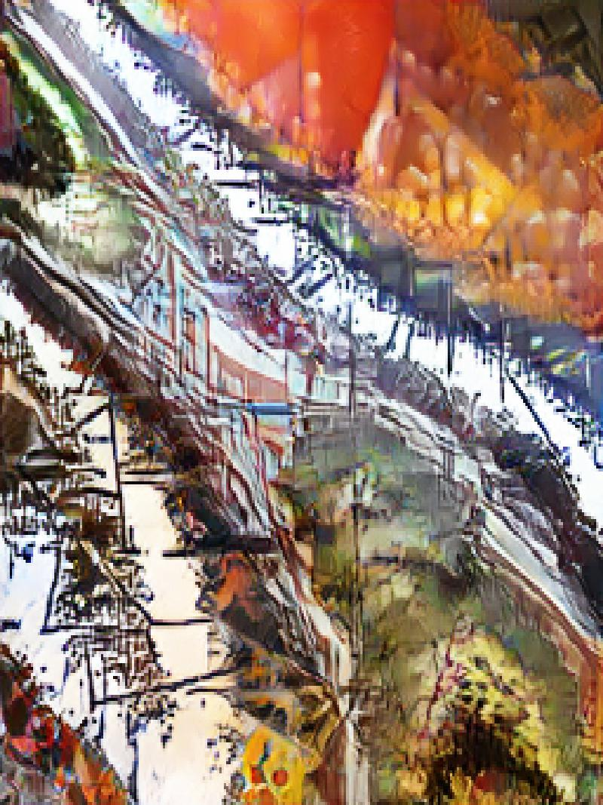
No pre-processing

Slide 10
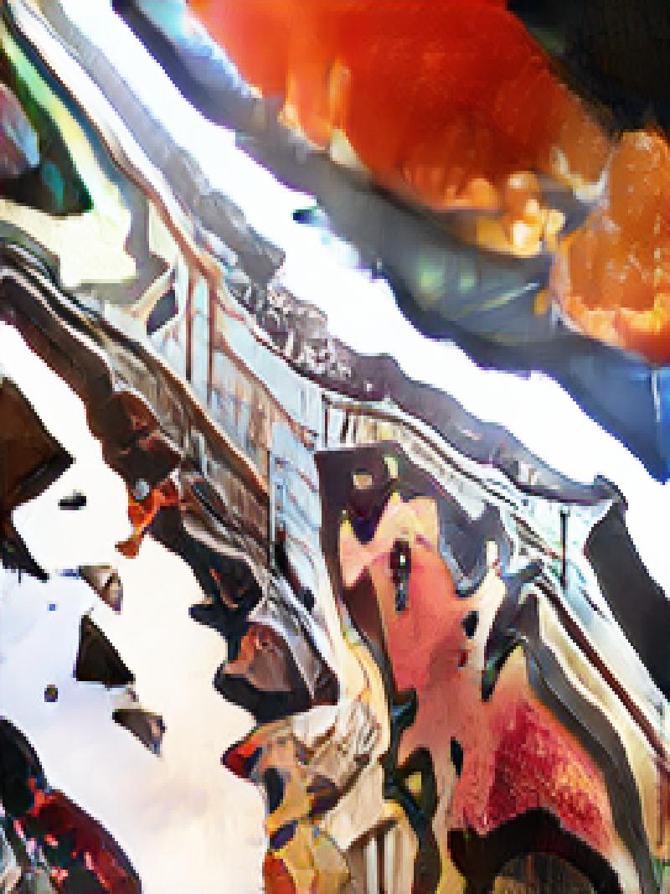
Gaussian blur pre-processing

Slide 11
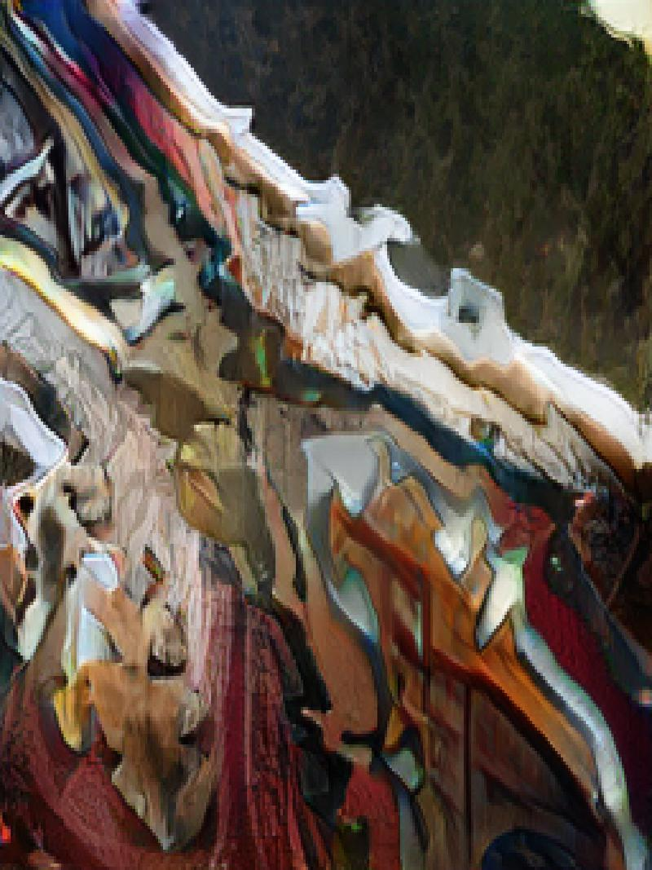
Invert + gaussian blur pre-processing

Slide 12
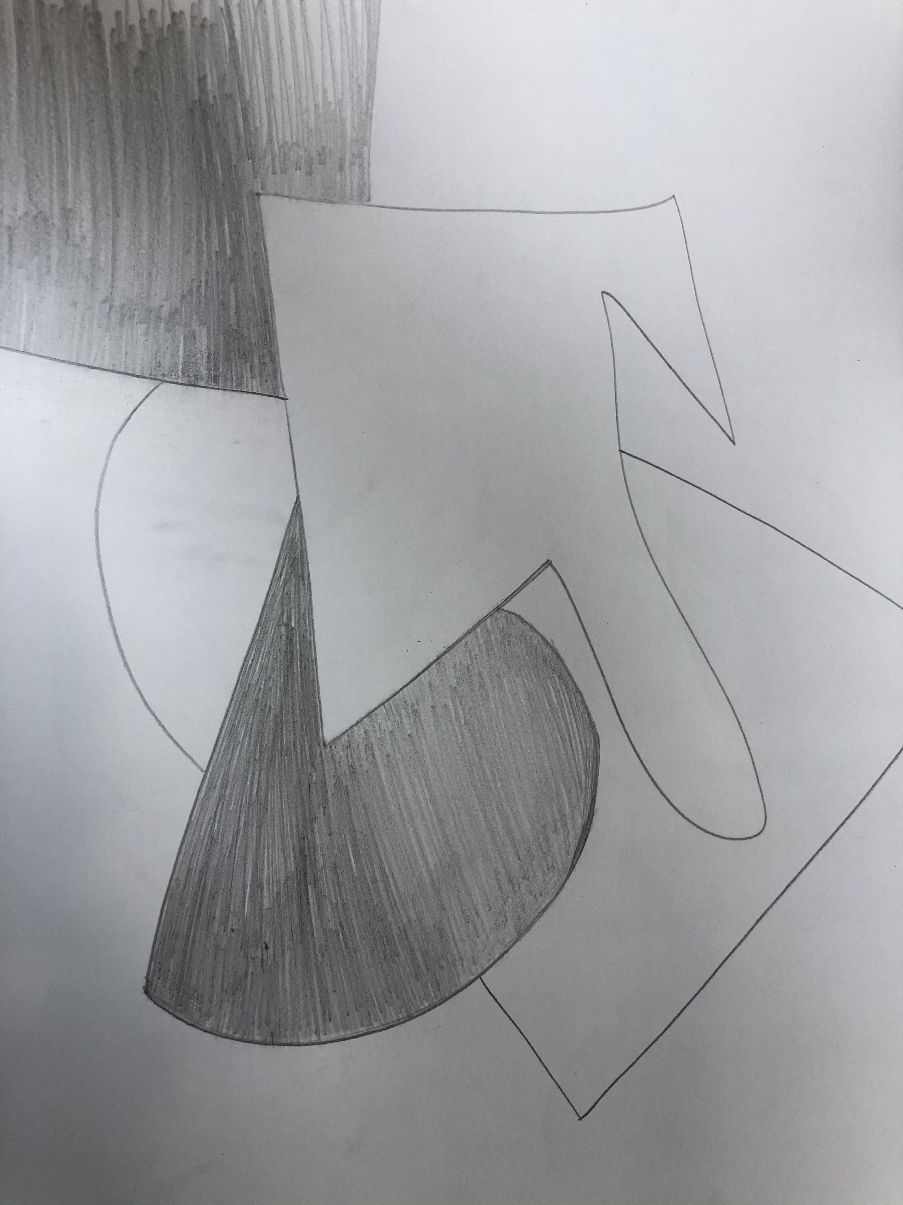
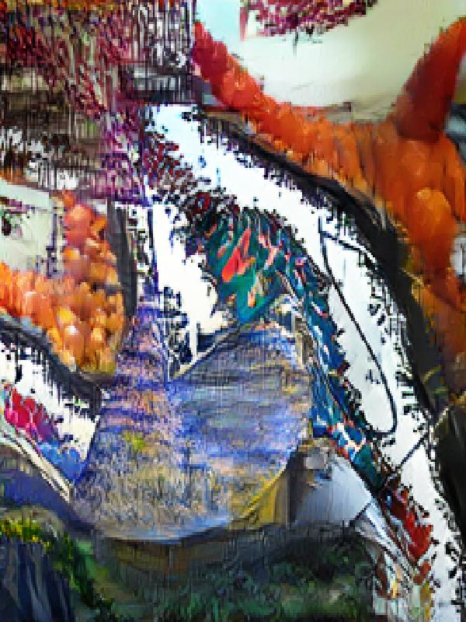
No pre-processing

Slide 13
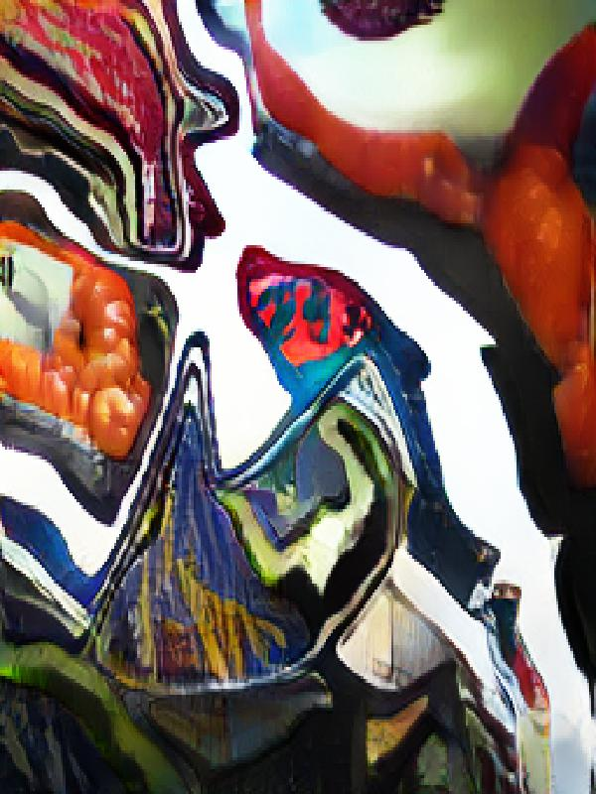
Gaussian blur pre-processing

Slide 14
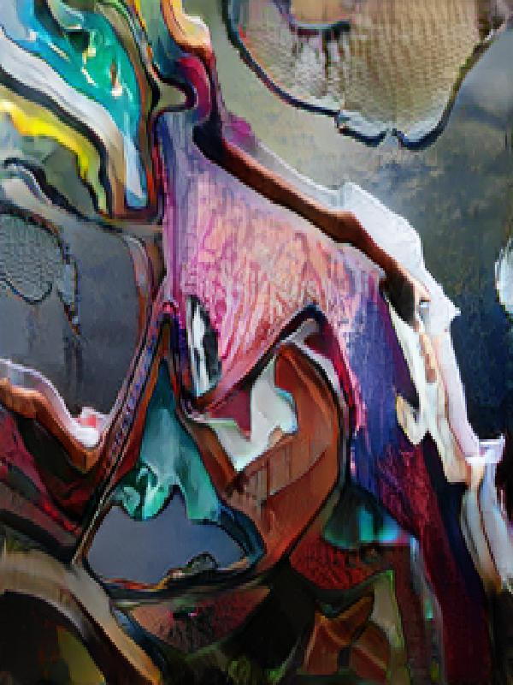
Invert + gaussian blur pre-processing

Slide 15
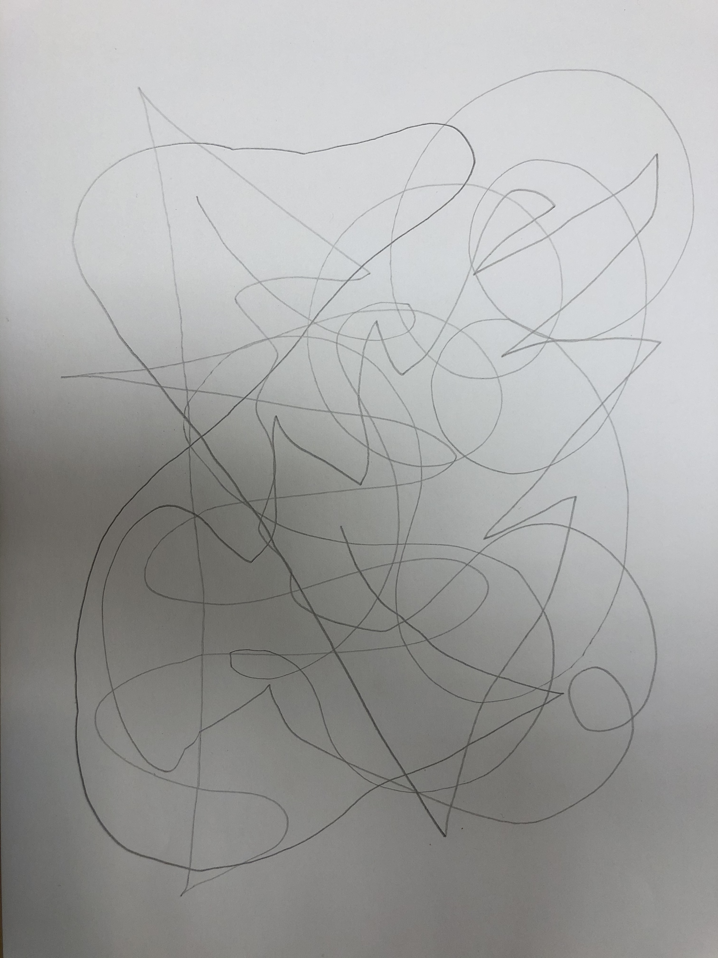
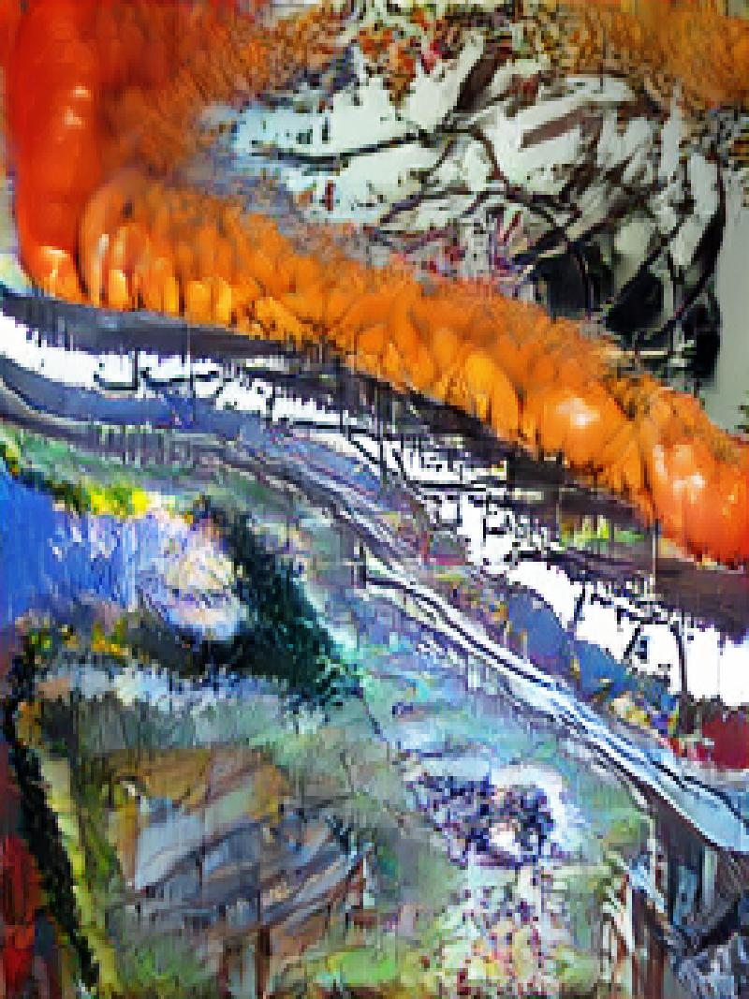
No pre-processing

Slide 16
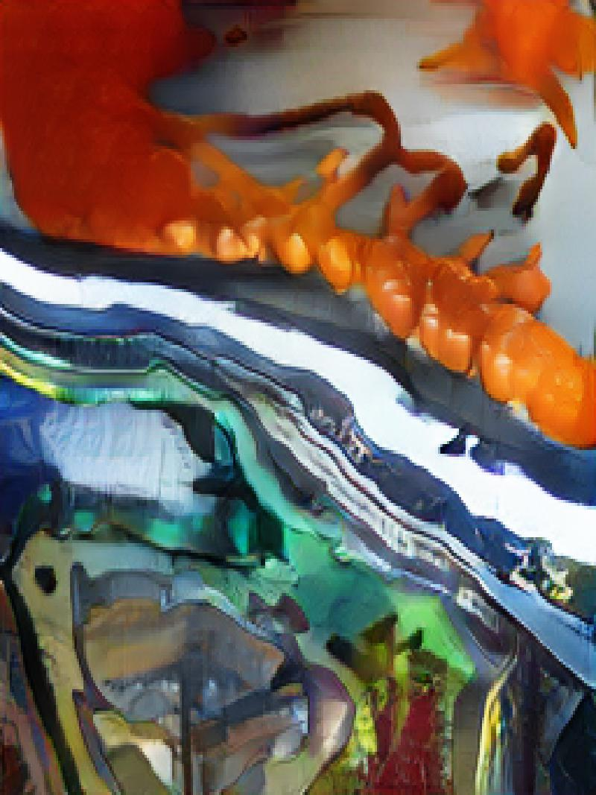
Gaussian blur pre-processing

Slide 17
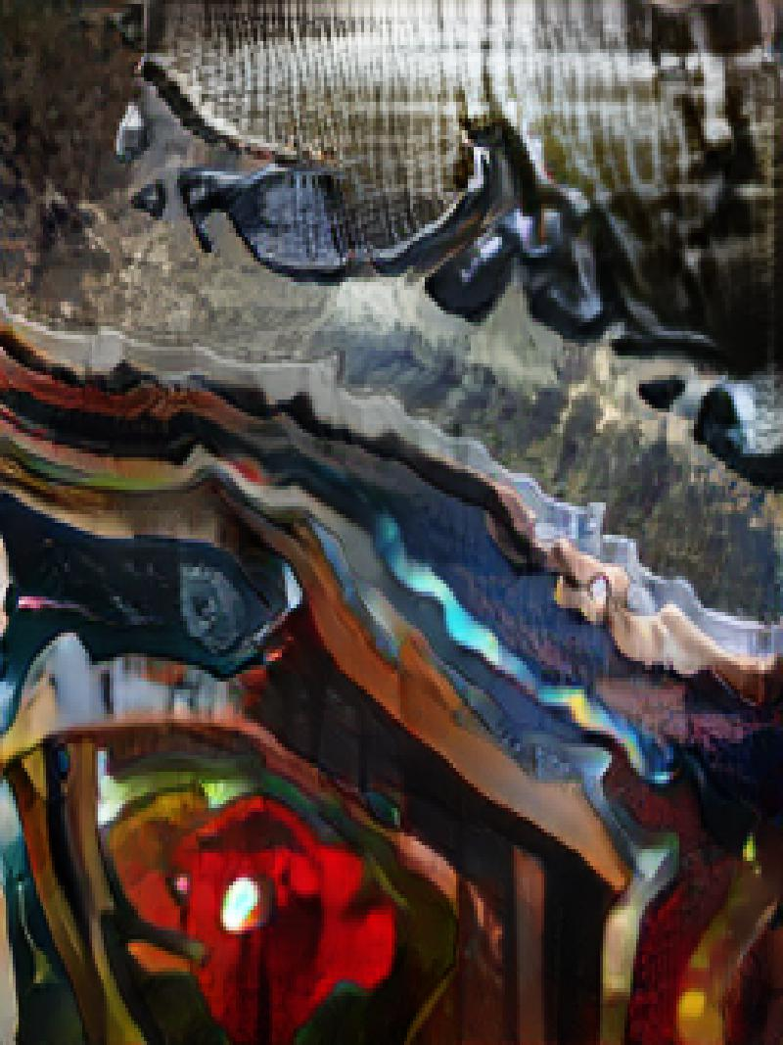
Invert + gaussian blur pre-processing

Slide 18
Digitally drawn inputs

Slide 19
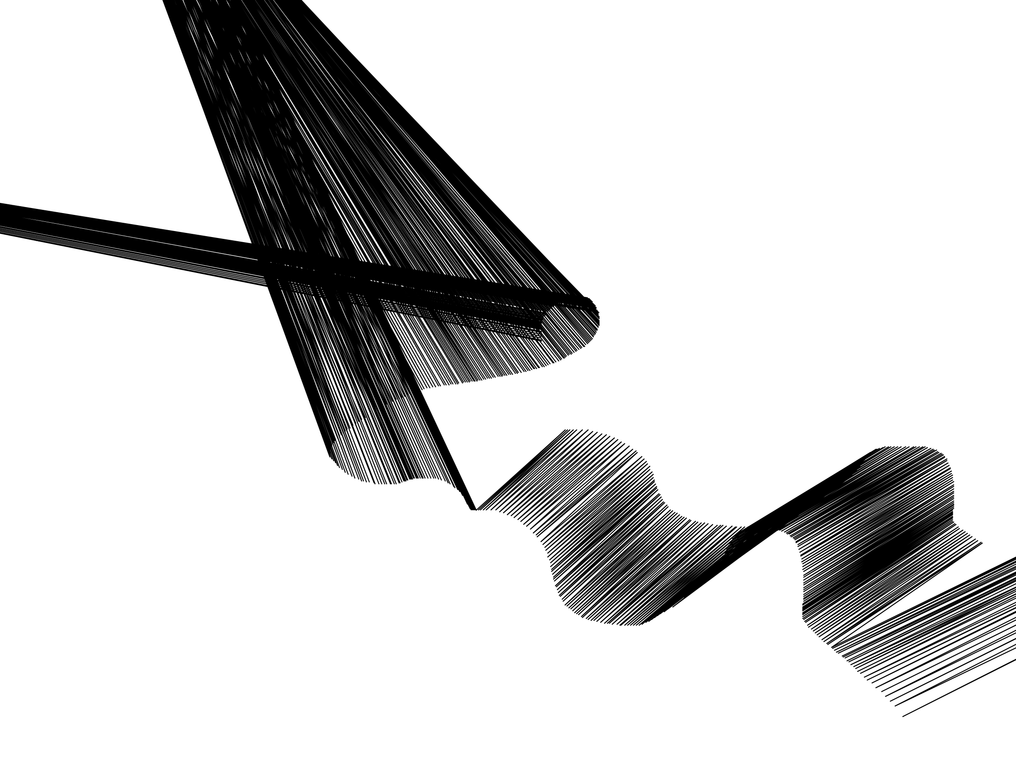
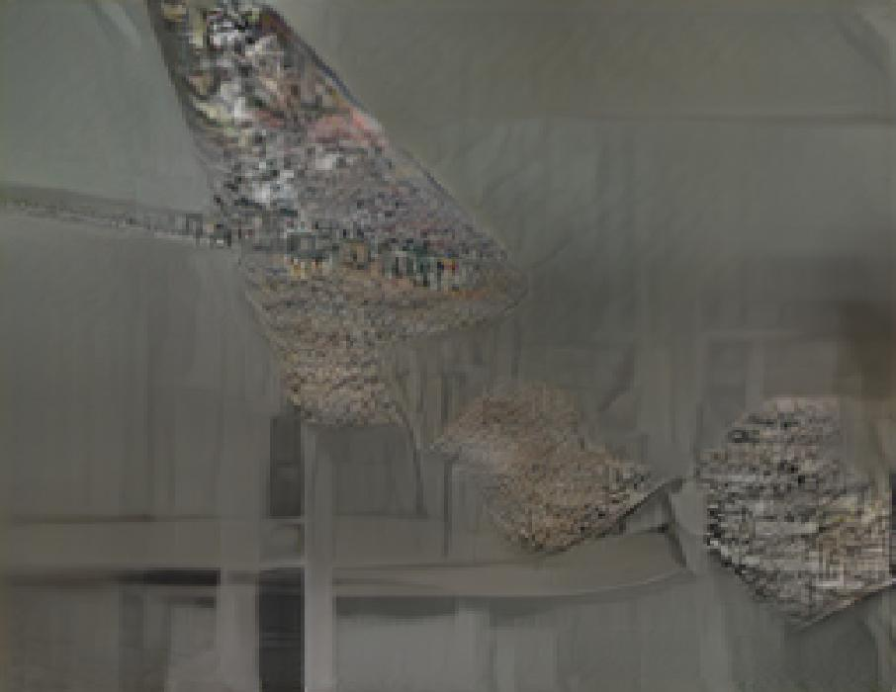
No pre-processing

Slide 20
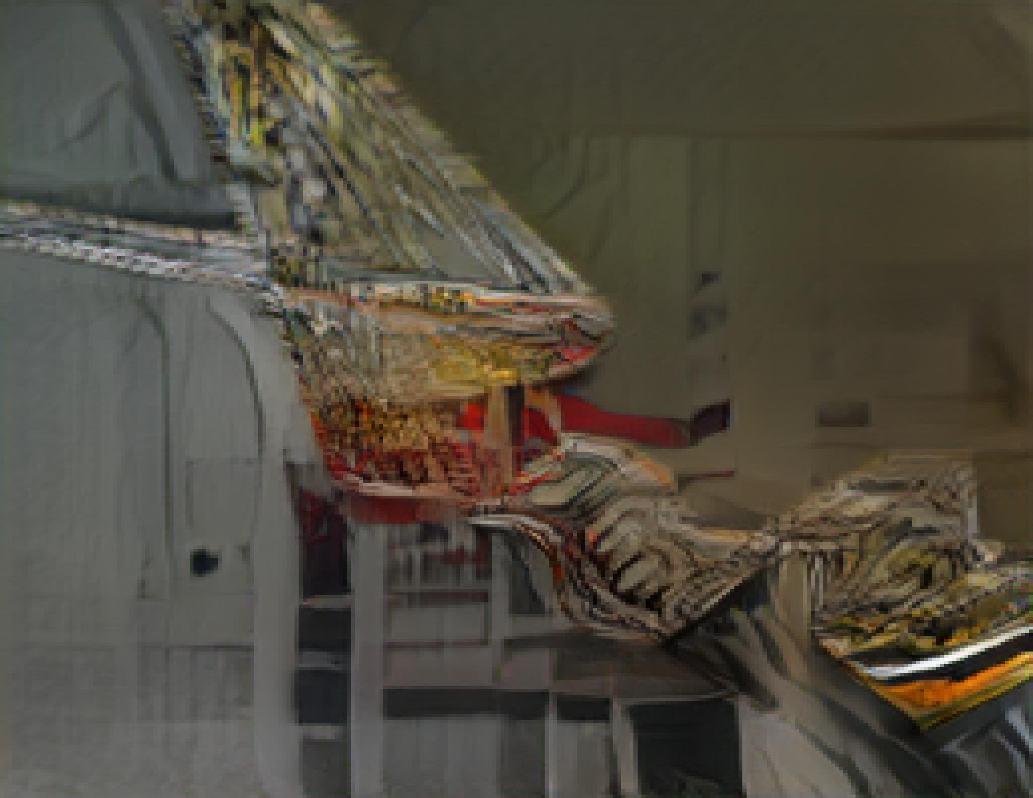
Gaussian blur pre-processing

Slide 21
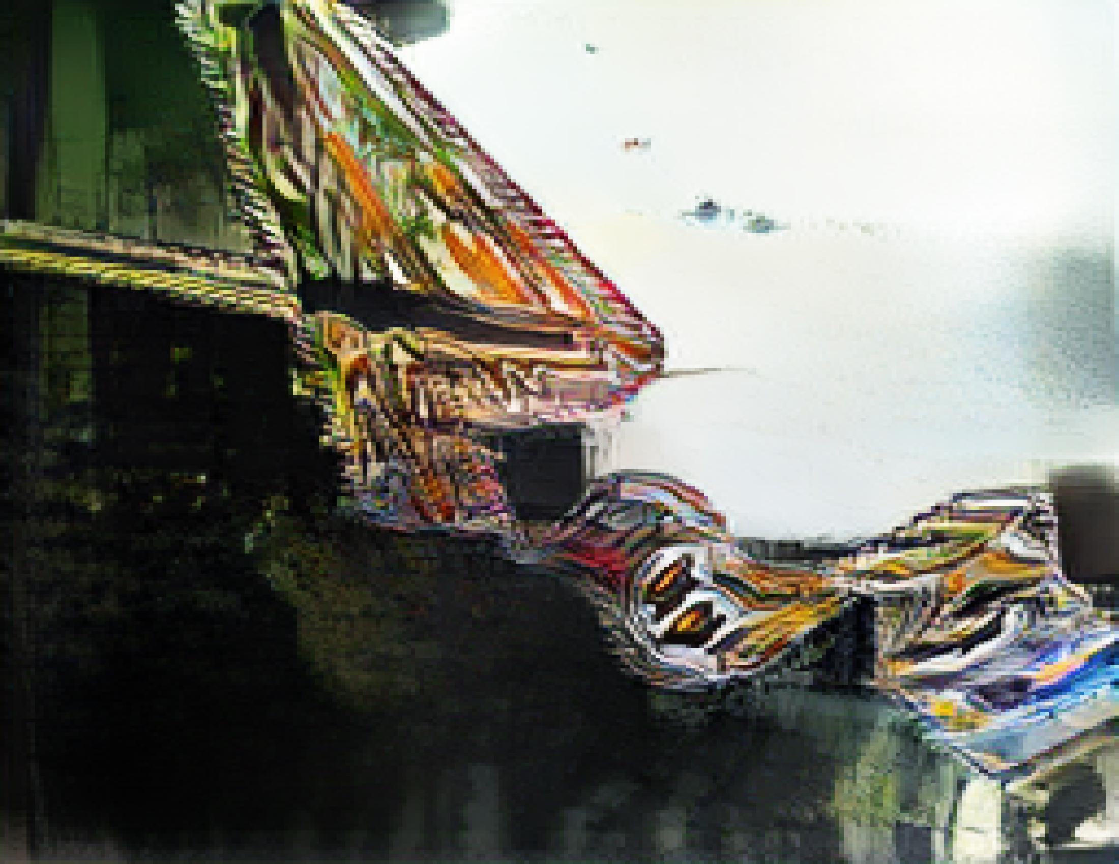
Invert + gaussian blur pre-processing

Slide 22
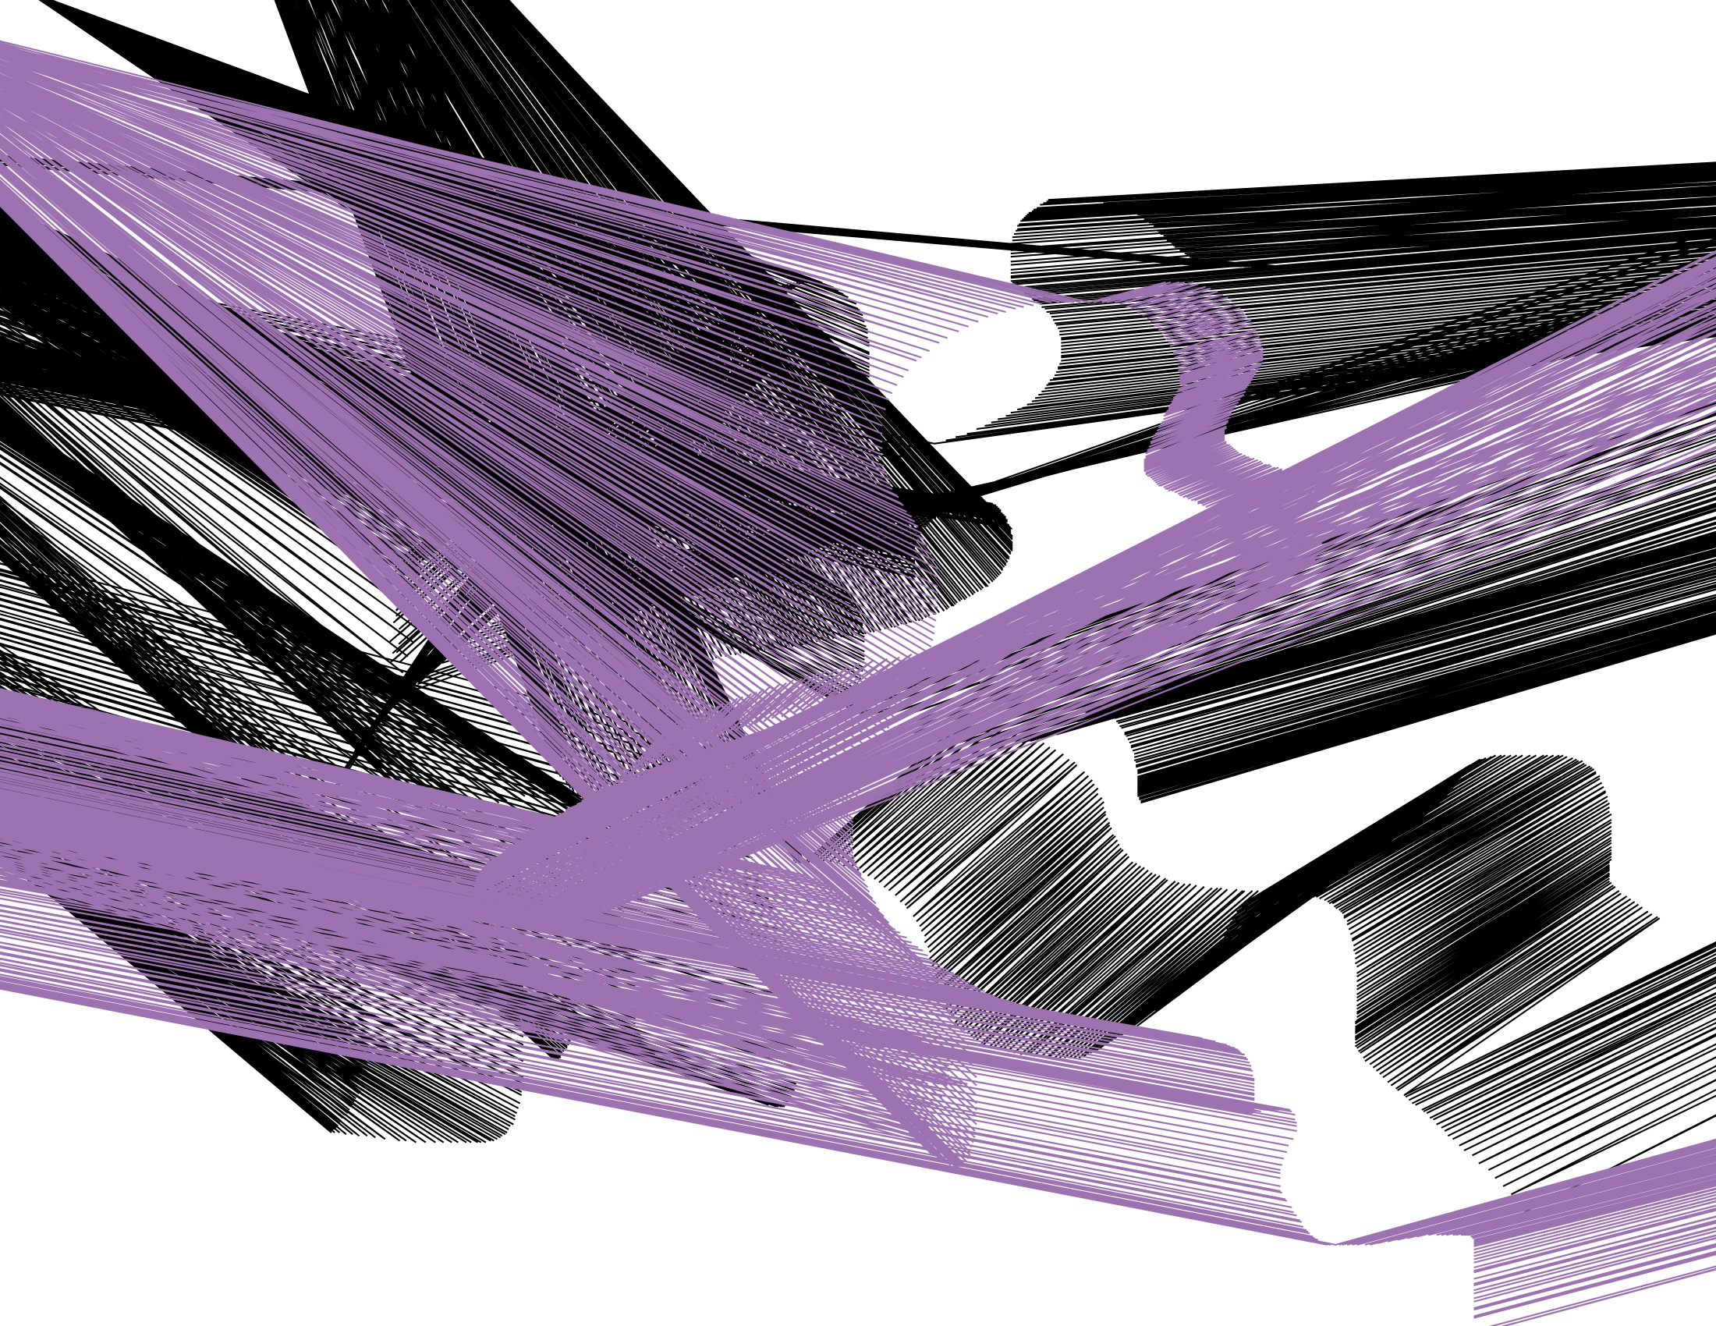
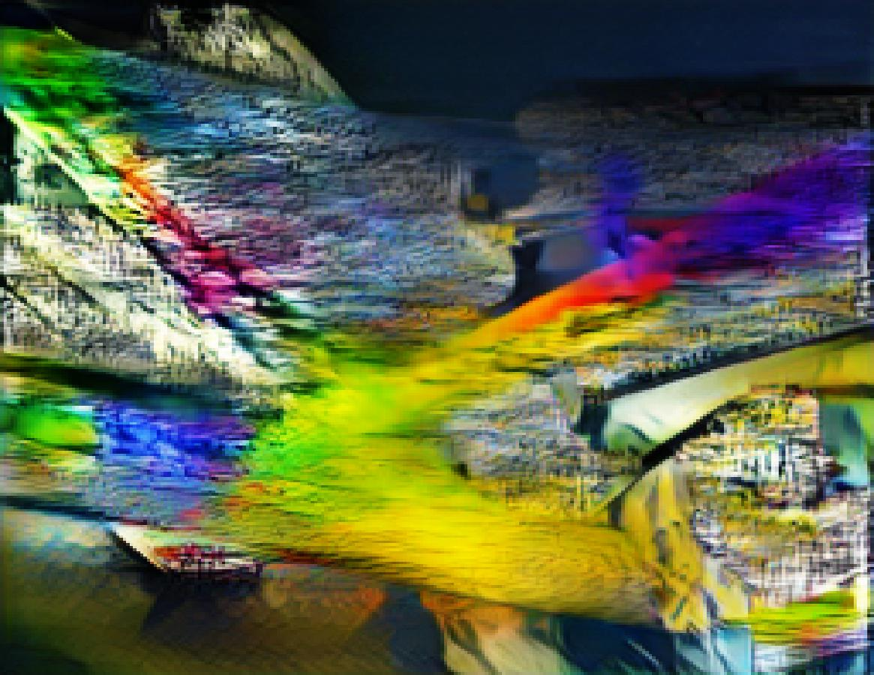
No pre-processing

Slide 23
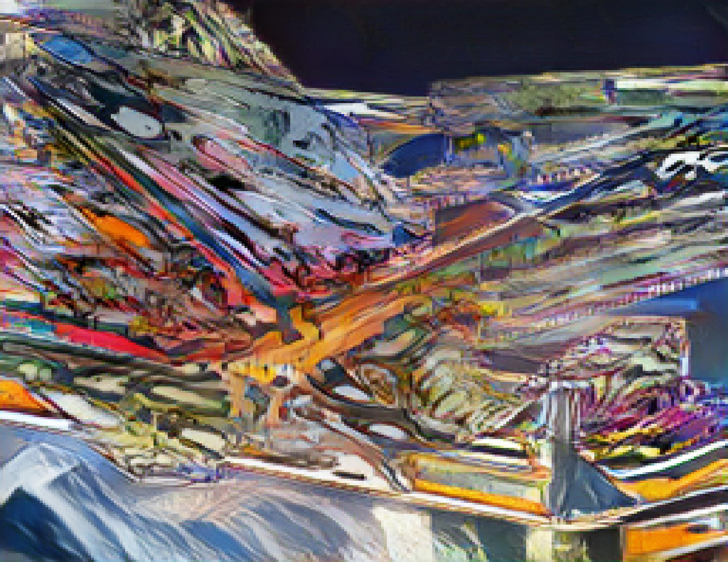
Gaussian blur pre-processing

Slide 24
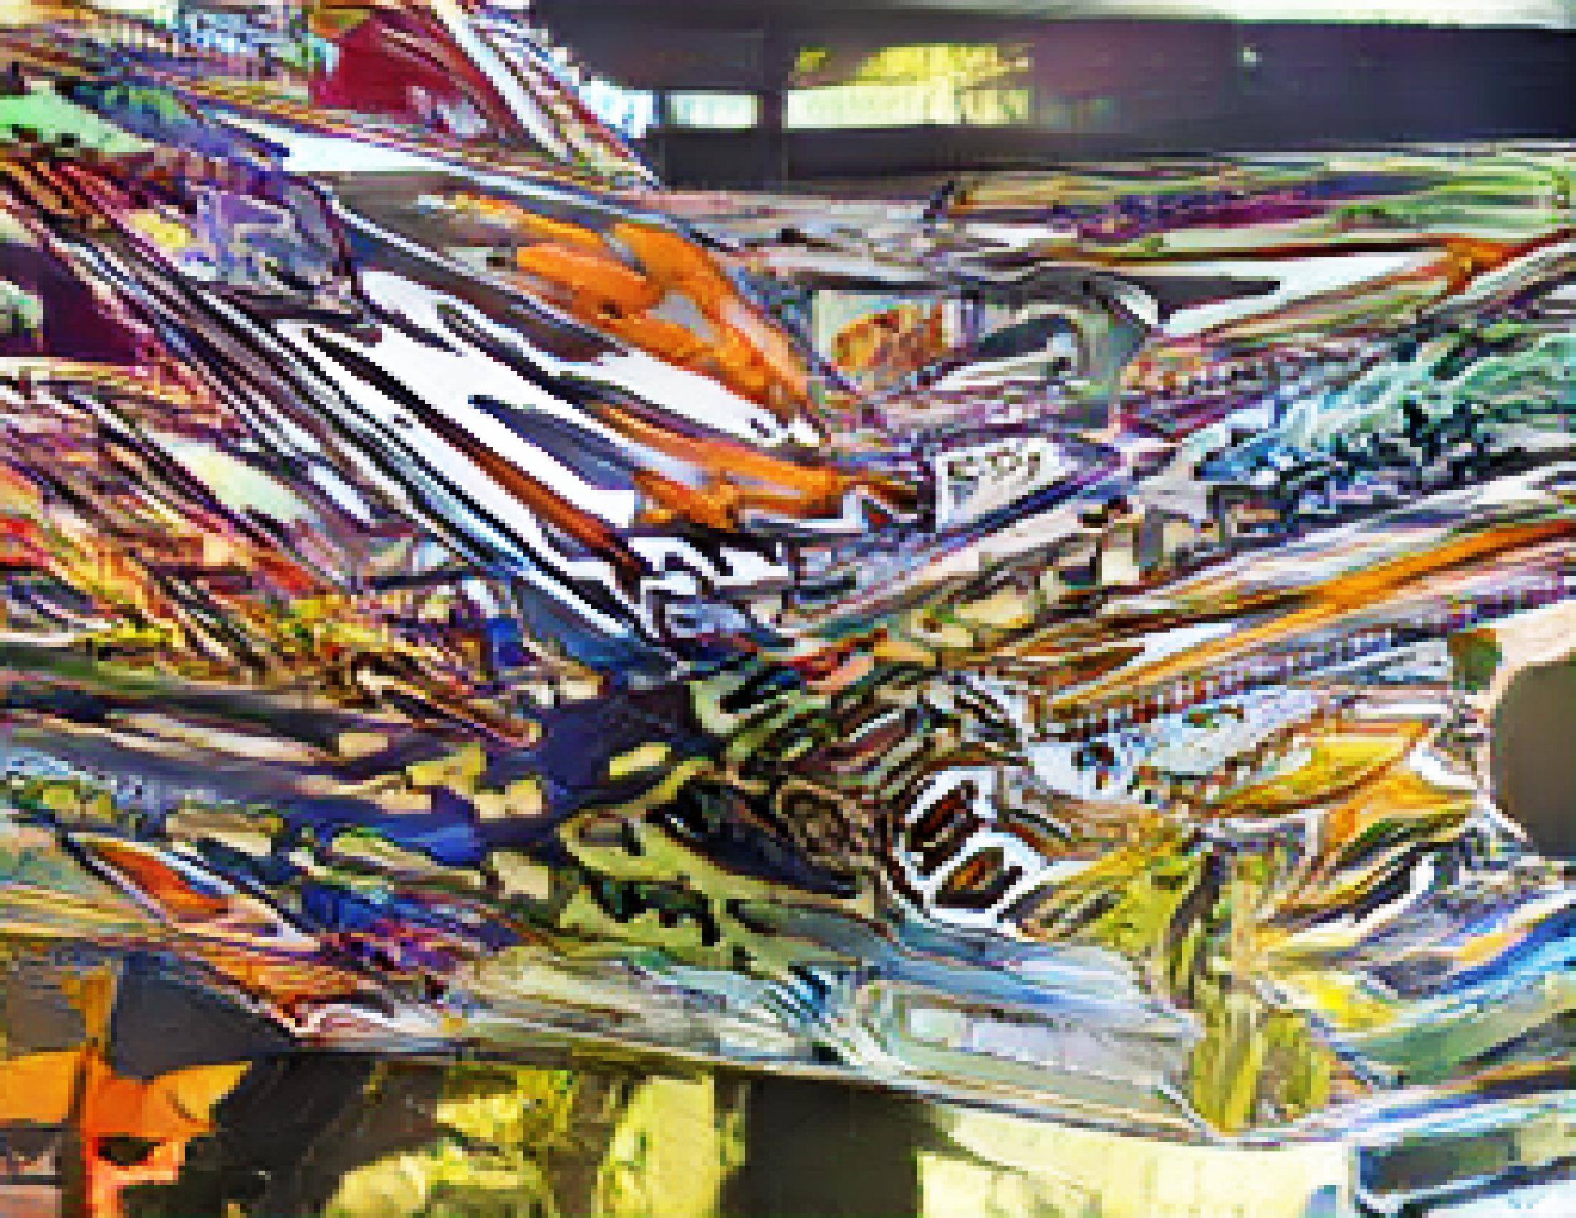
Invert + gaussian blur pre-processing

Slide 25
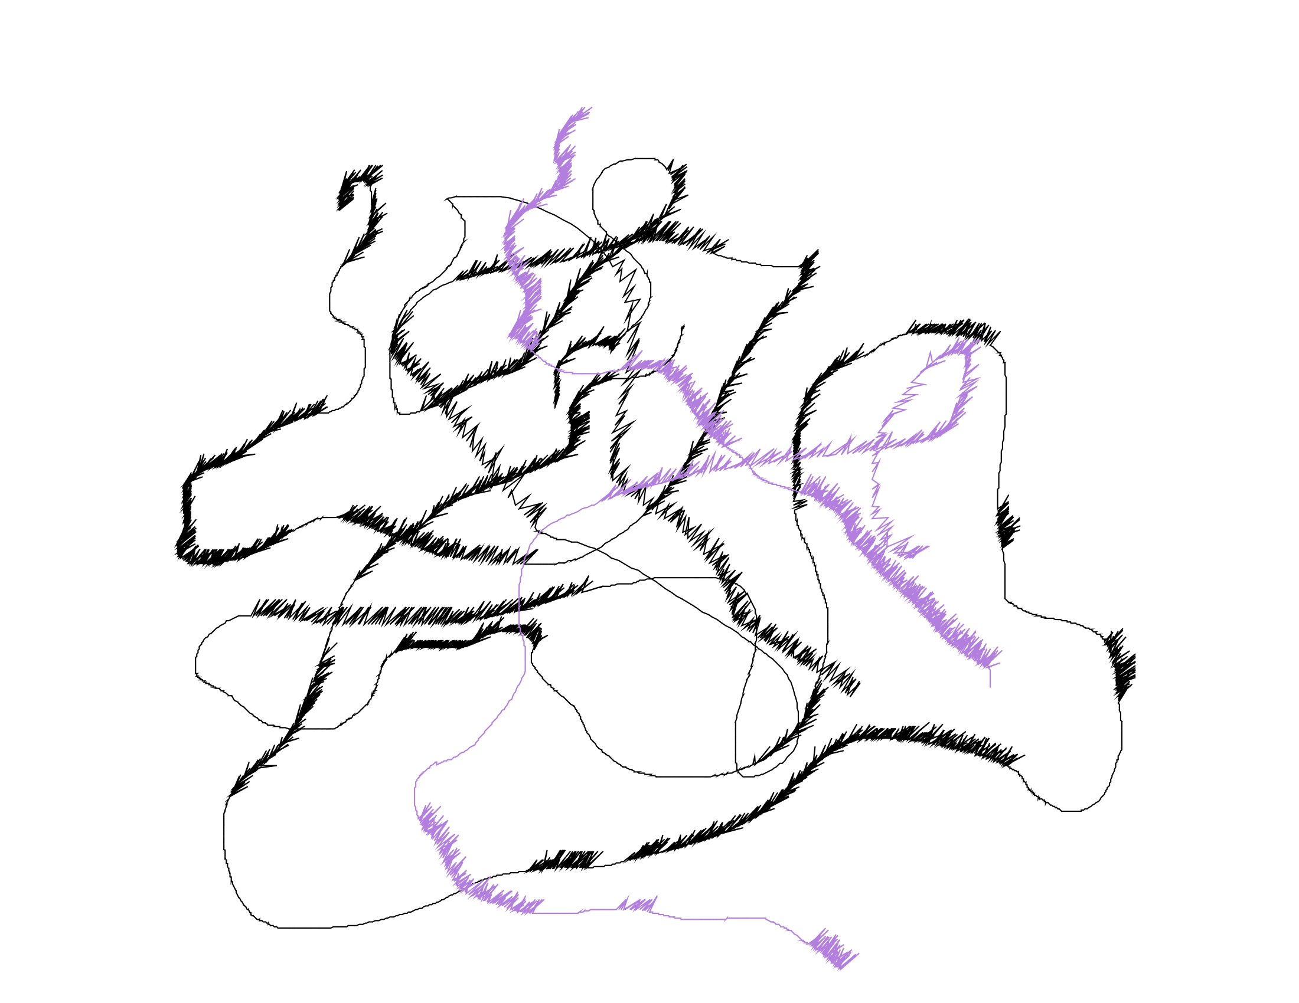
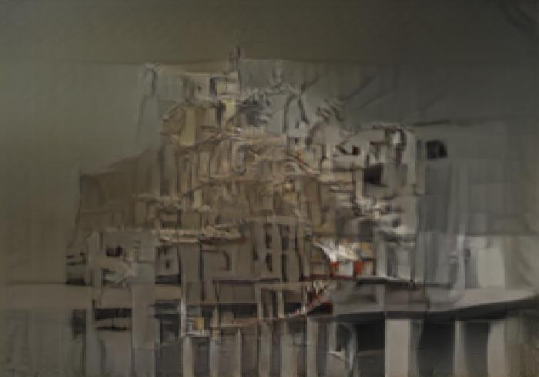
No pre-processing

Slide 26
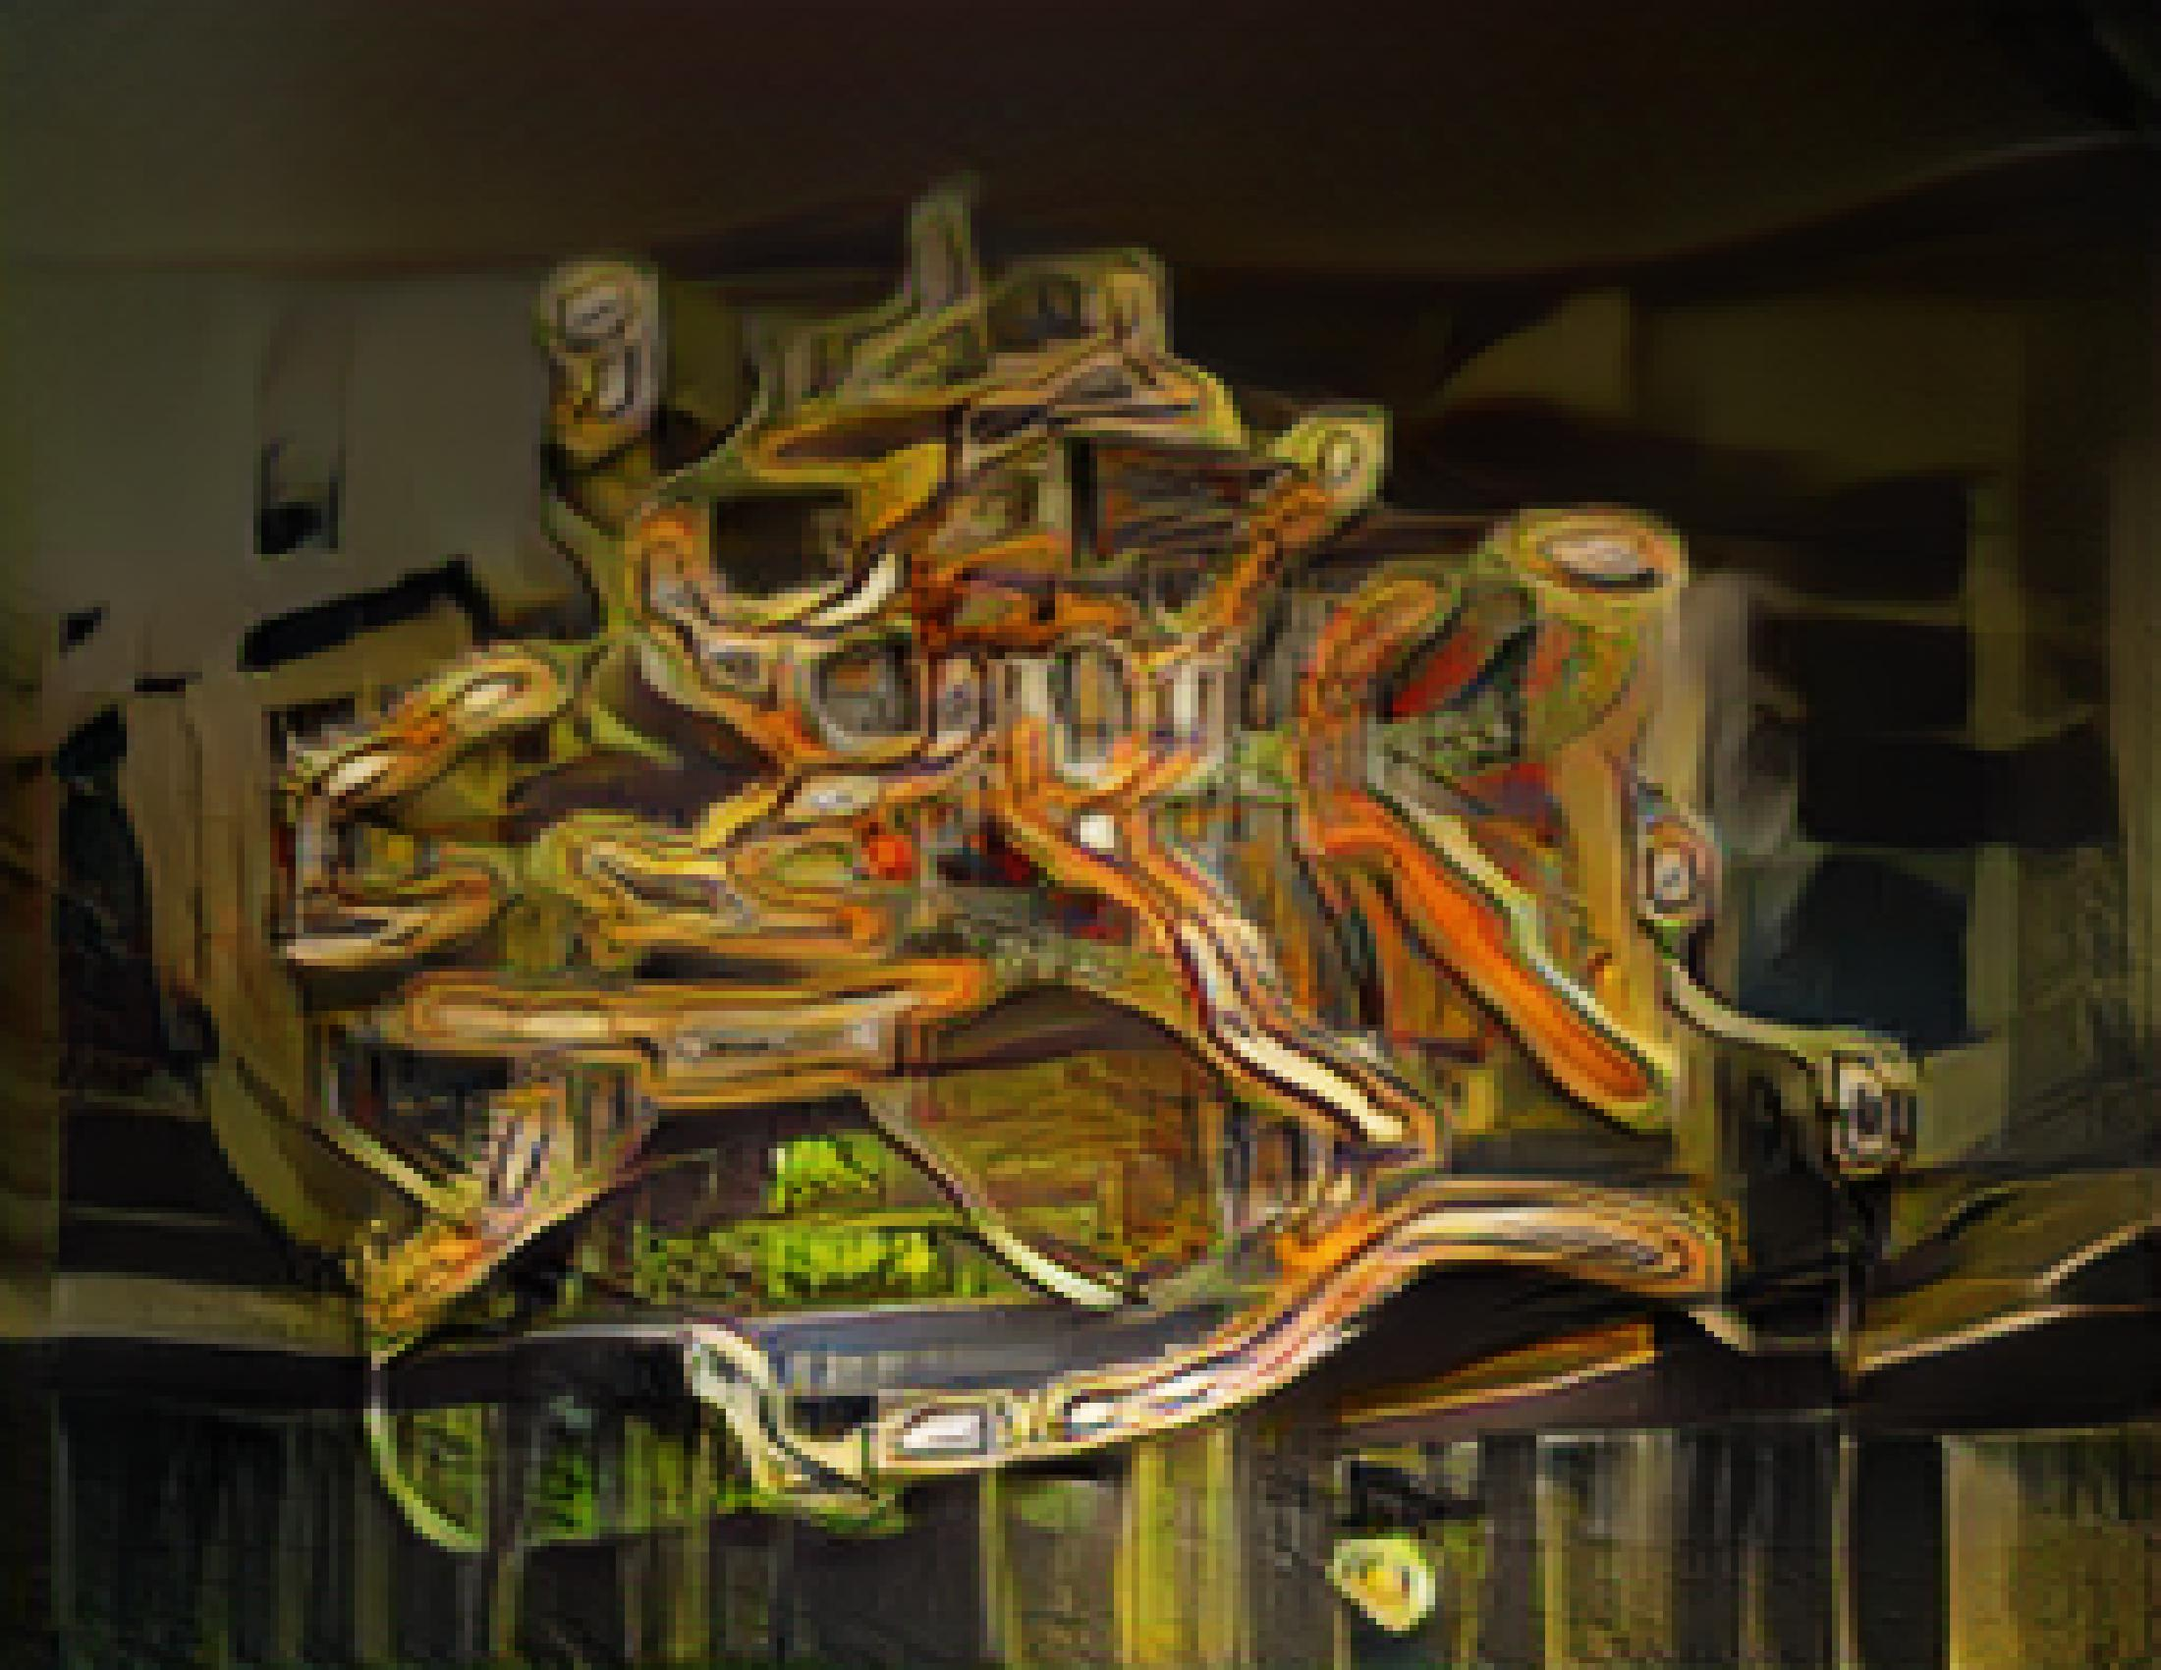
Gaussian blur pre-processing

Slide 27
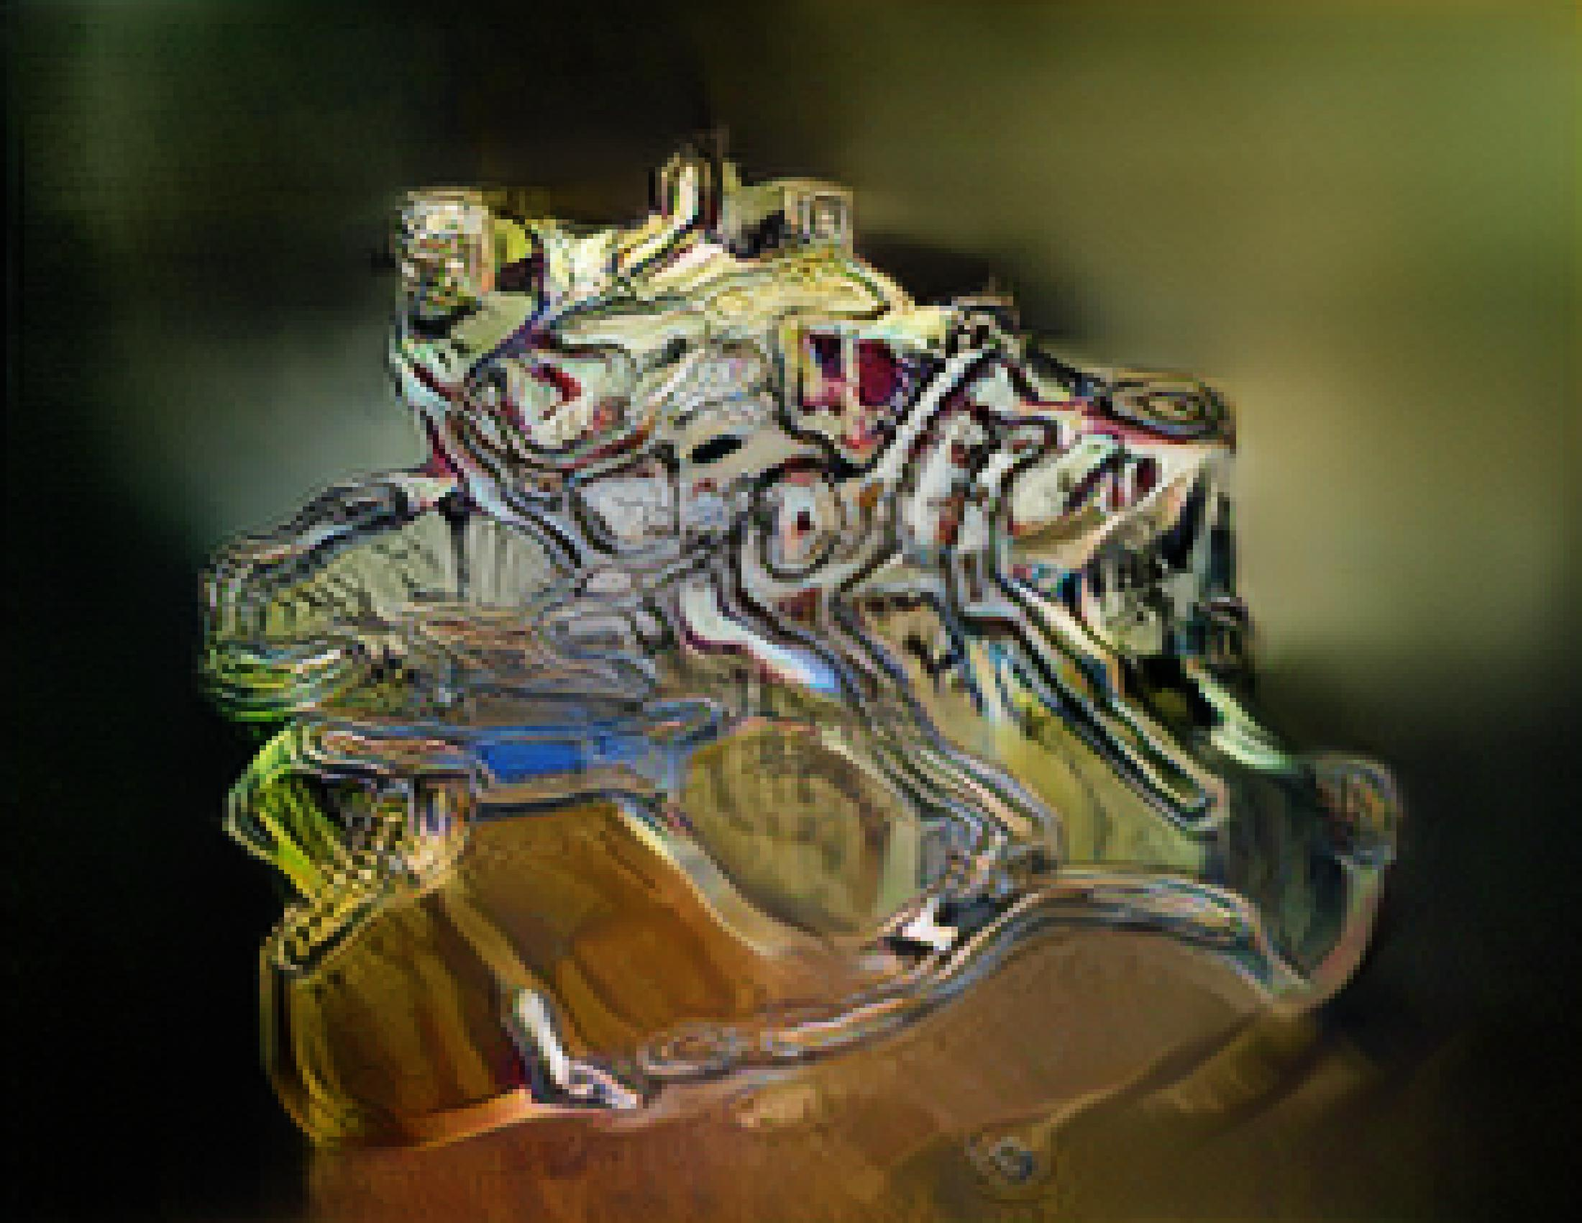
Invert + gaussian blur pre-processing

Slide 28

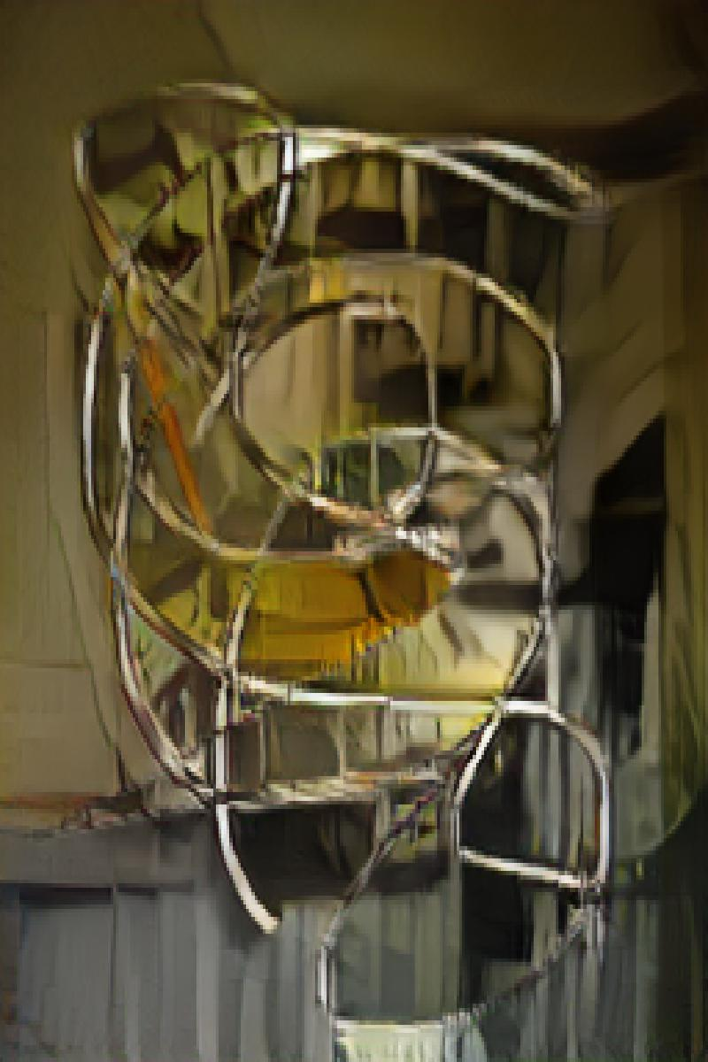
No pre-processing

Slide 29
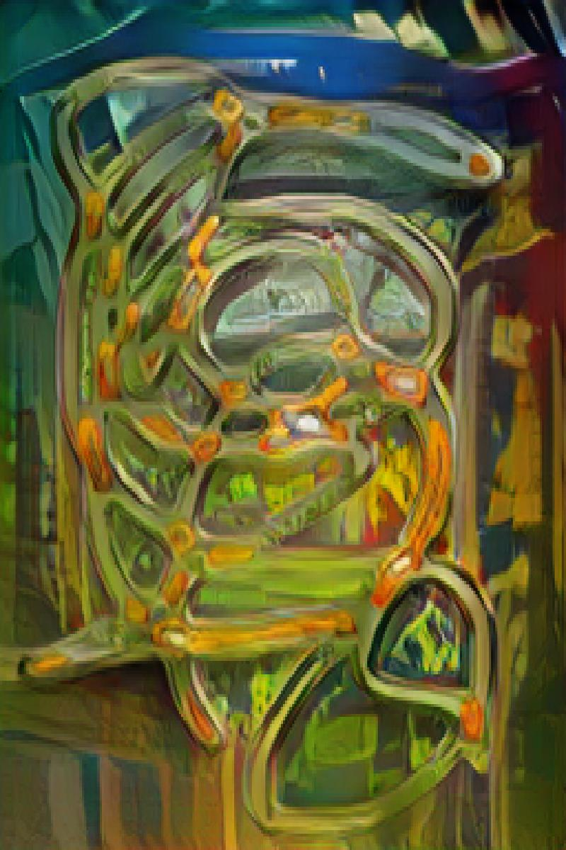
Gaussian blur pre-processing

Slide 30
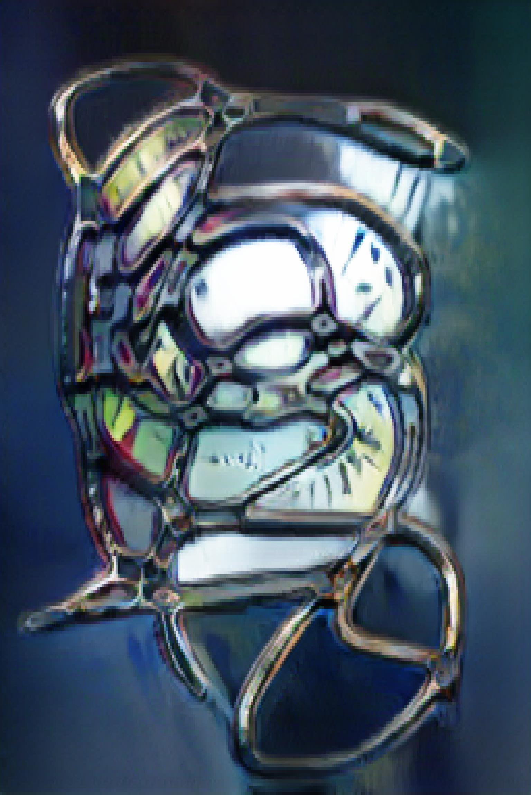
Invert + gaussian blur pre-processing

Slide 31
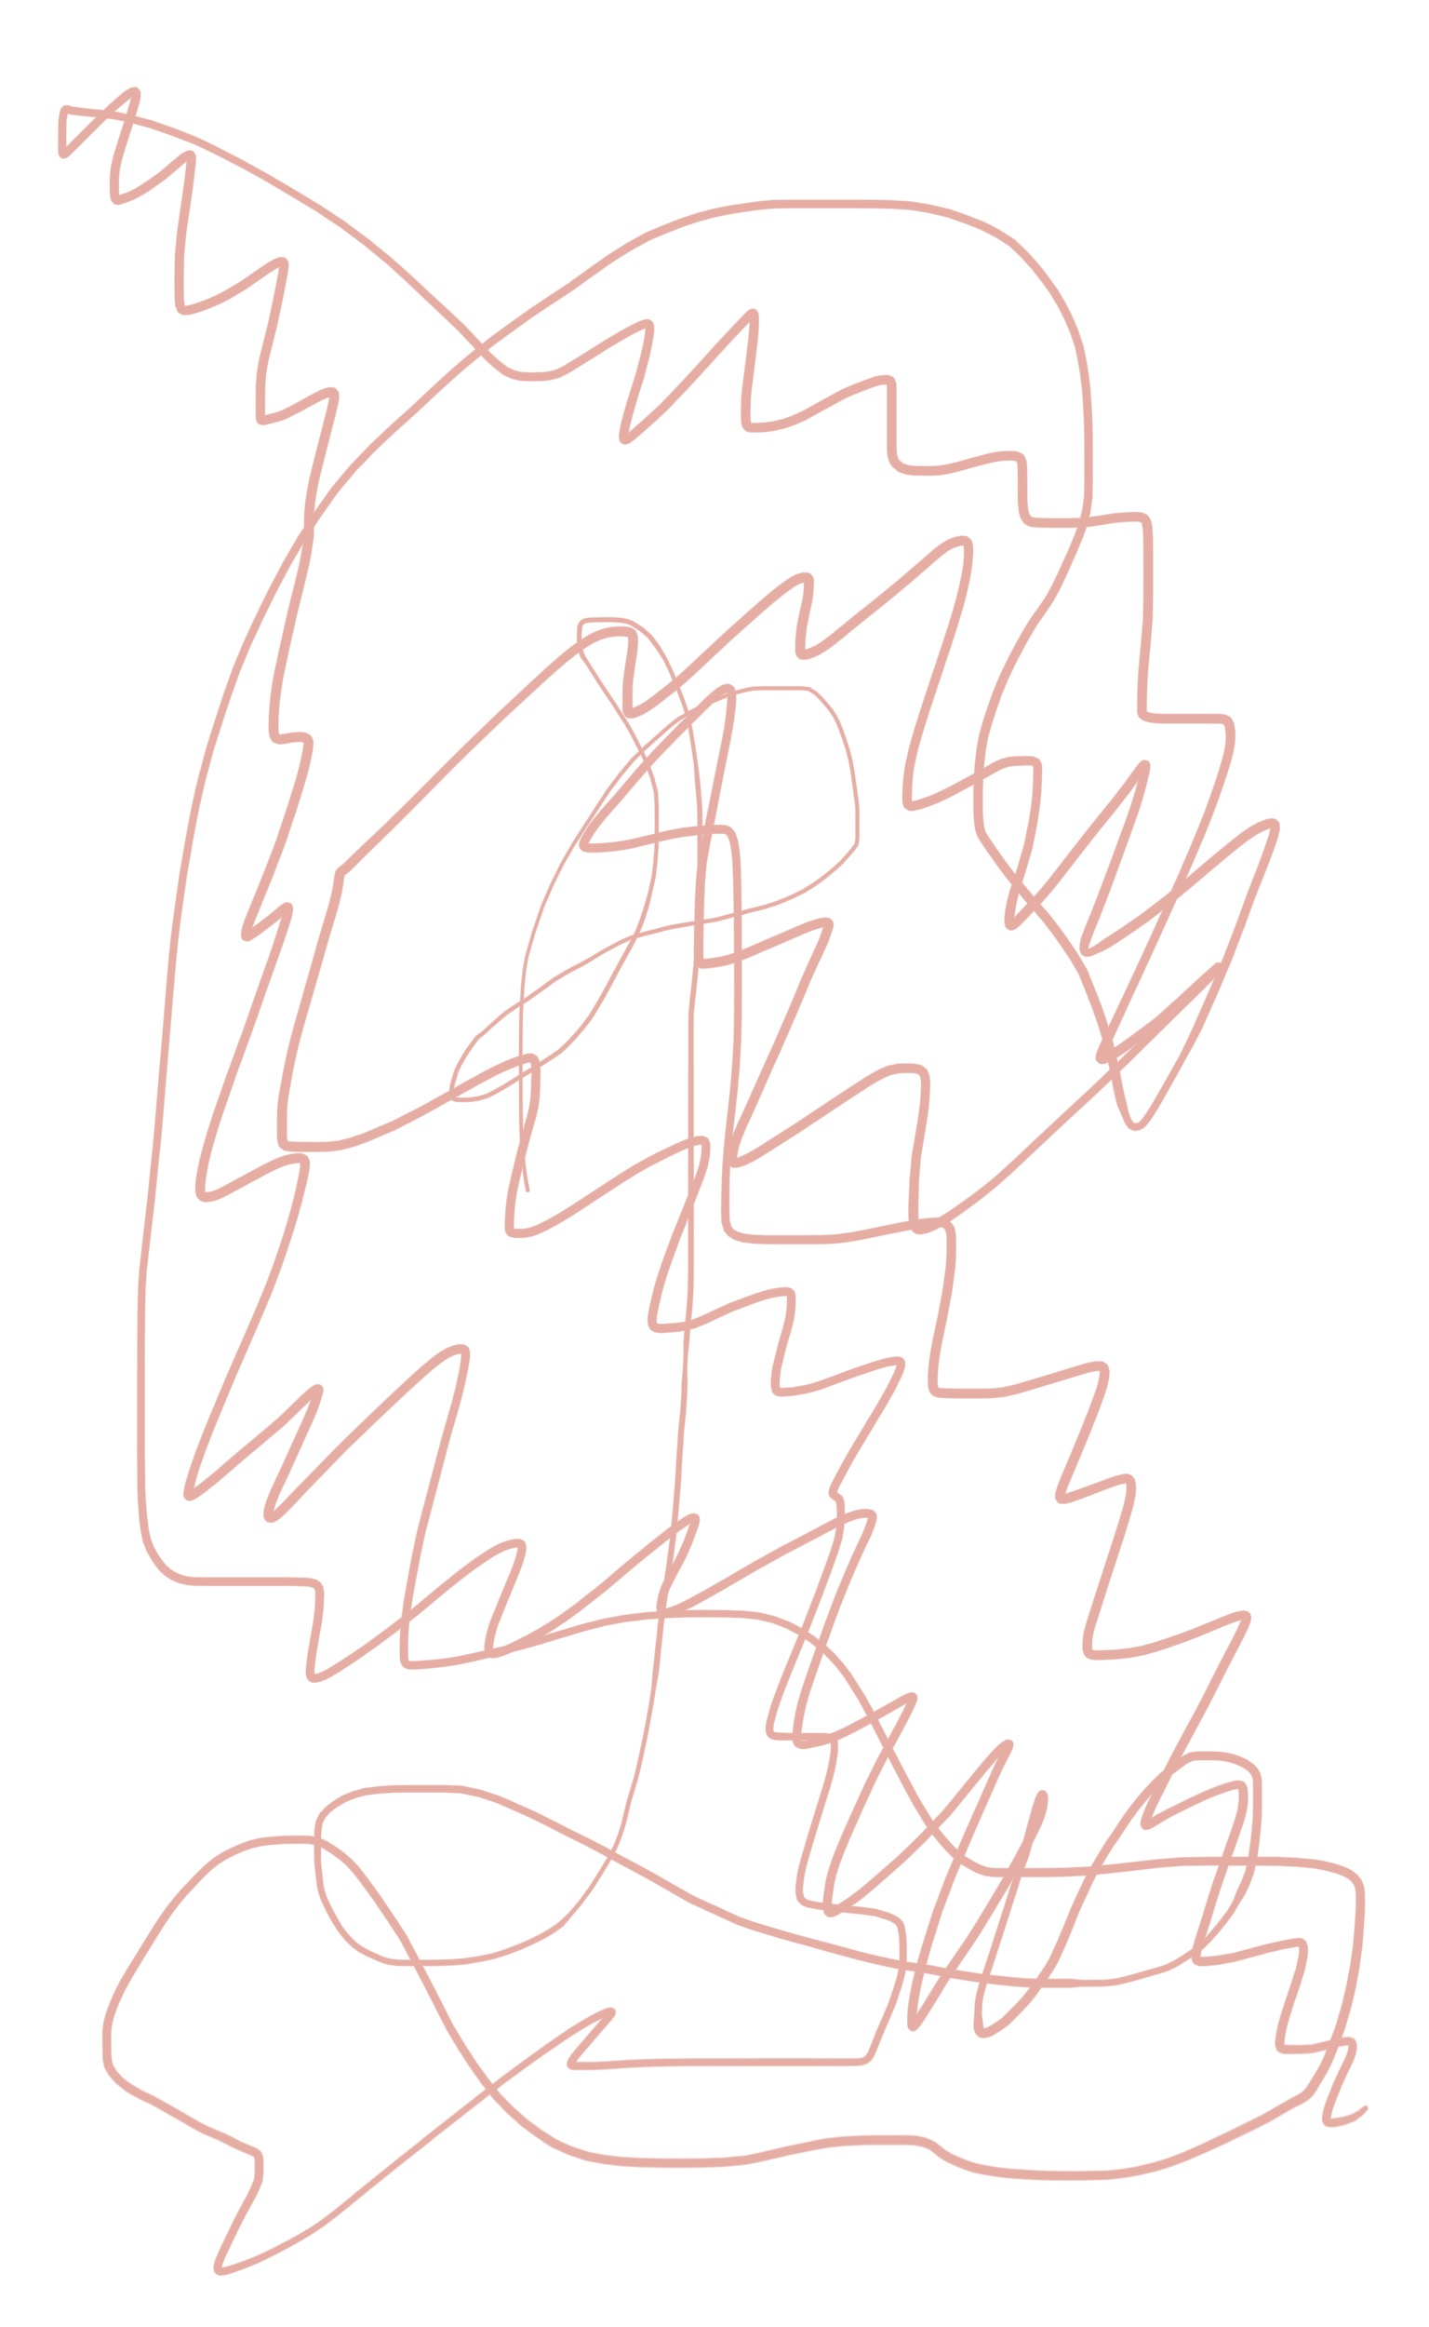
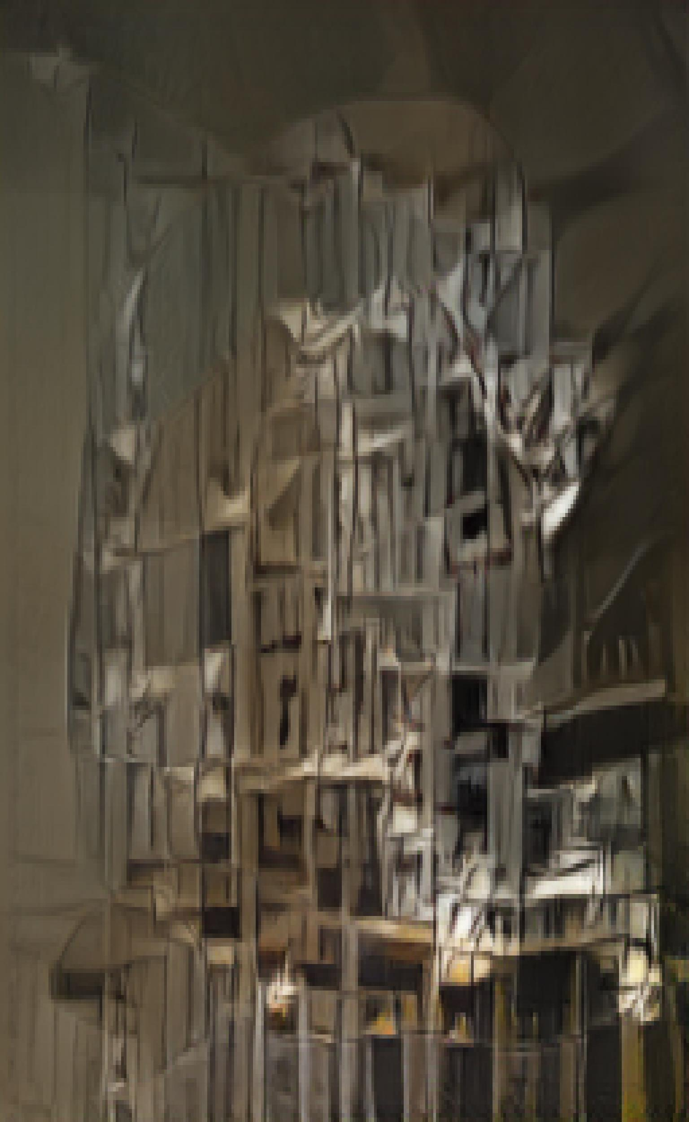
No pre-processing

Slide 32
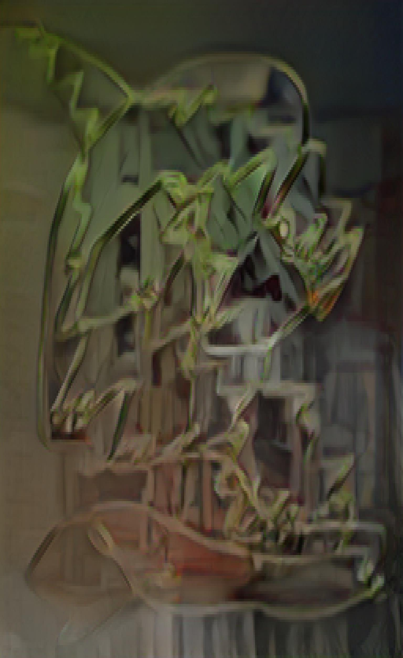
Gaussian blur pre-processing

Slide 33
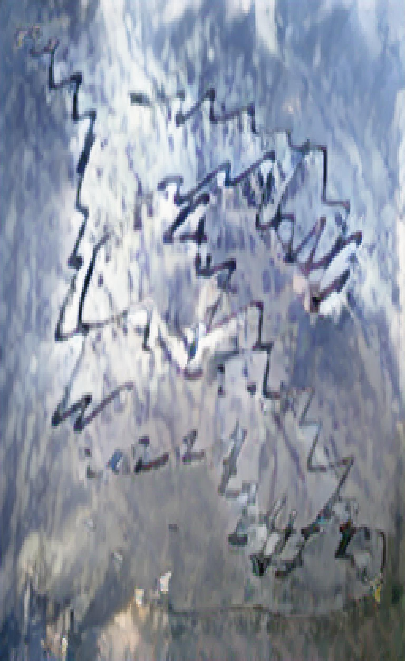
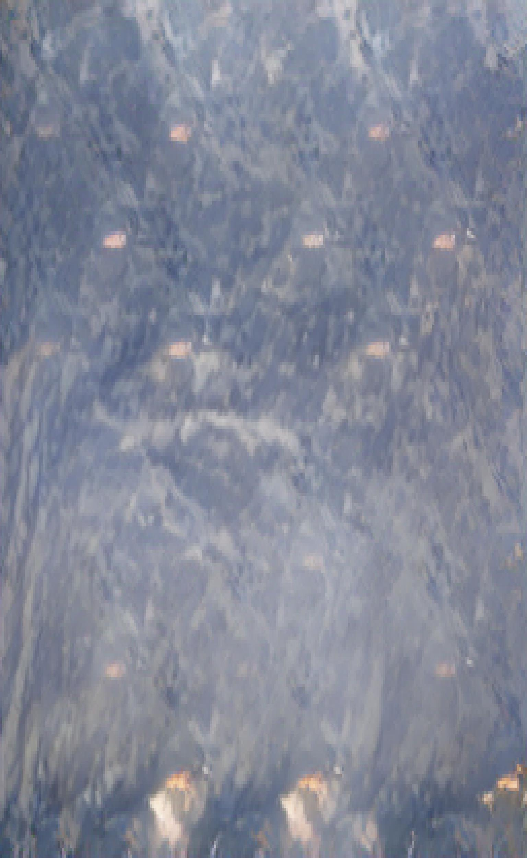
Invert + gaussian blur pre-processing

Slide 34
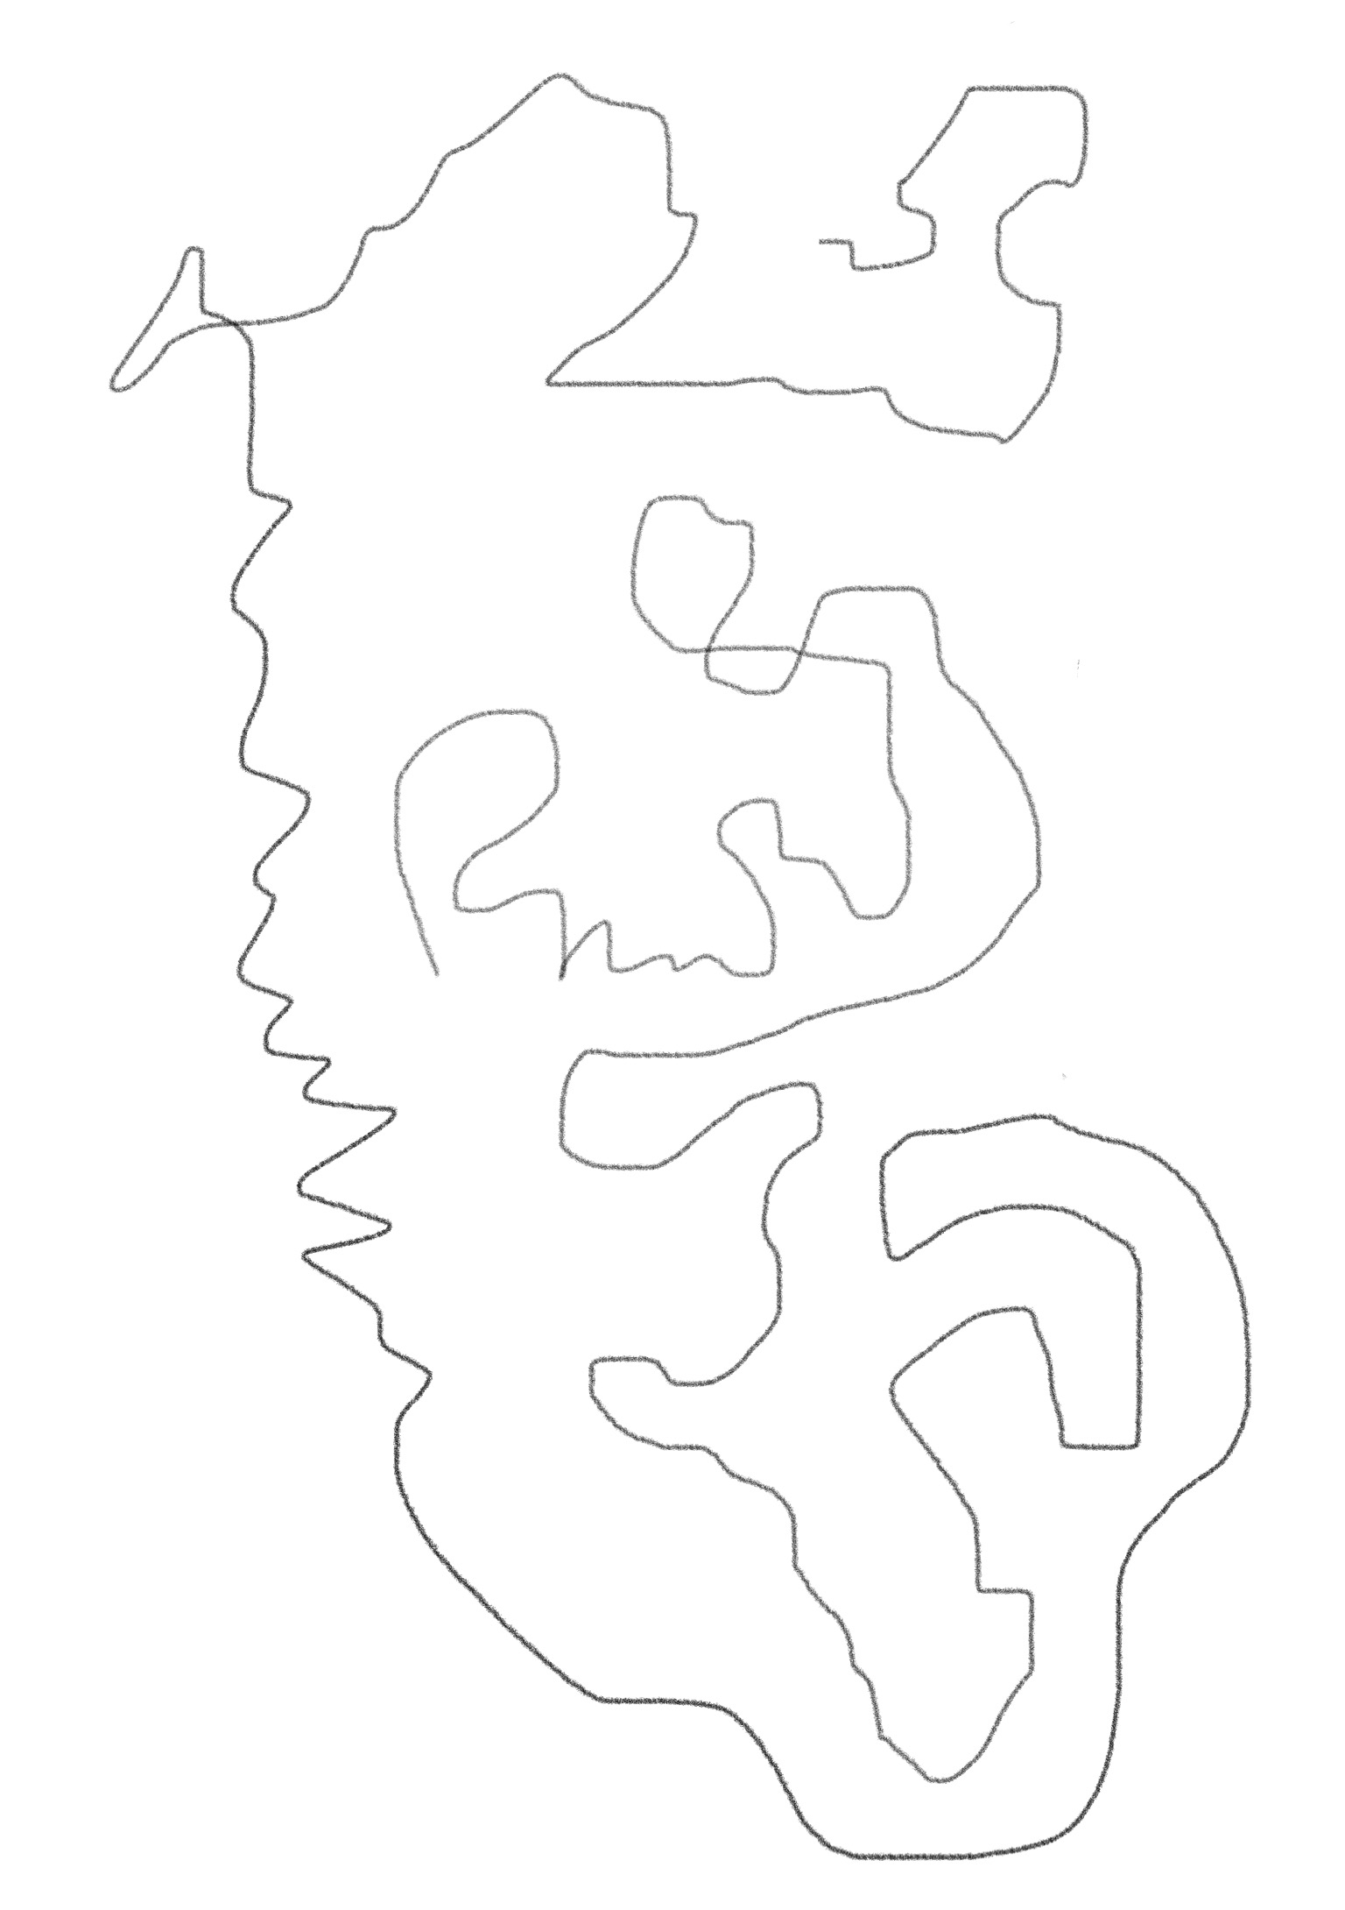
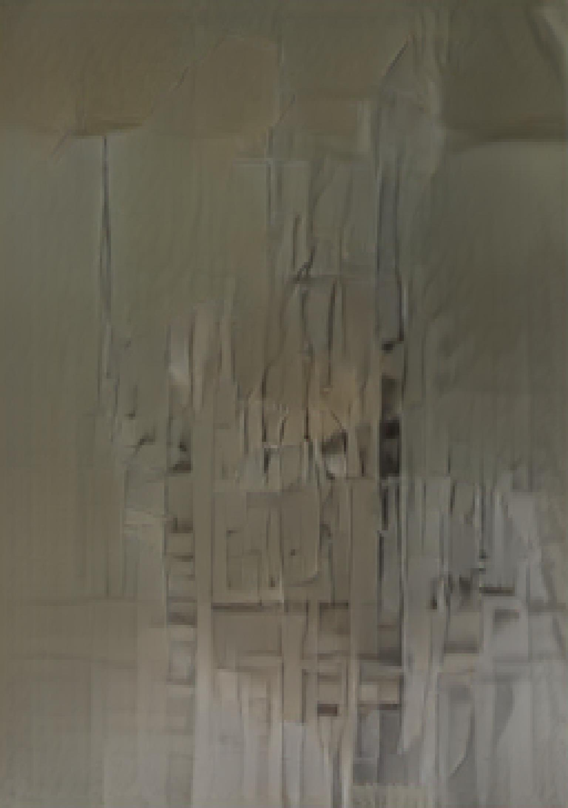
No pre-processing

Slide 35
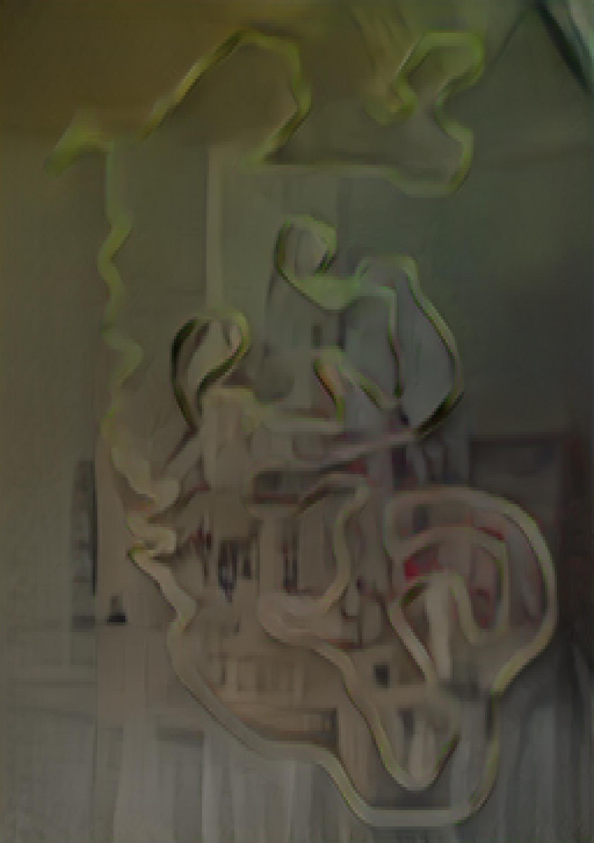
Gaussian blur pre-processing

Slide 36
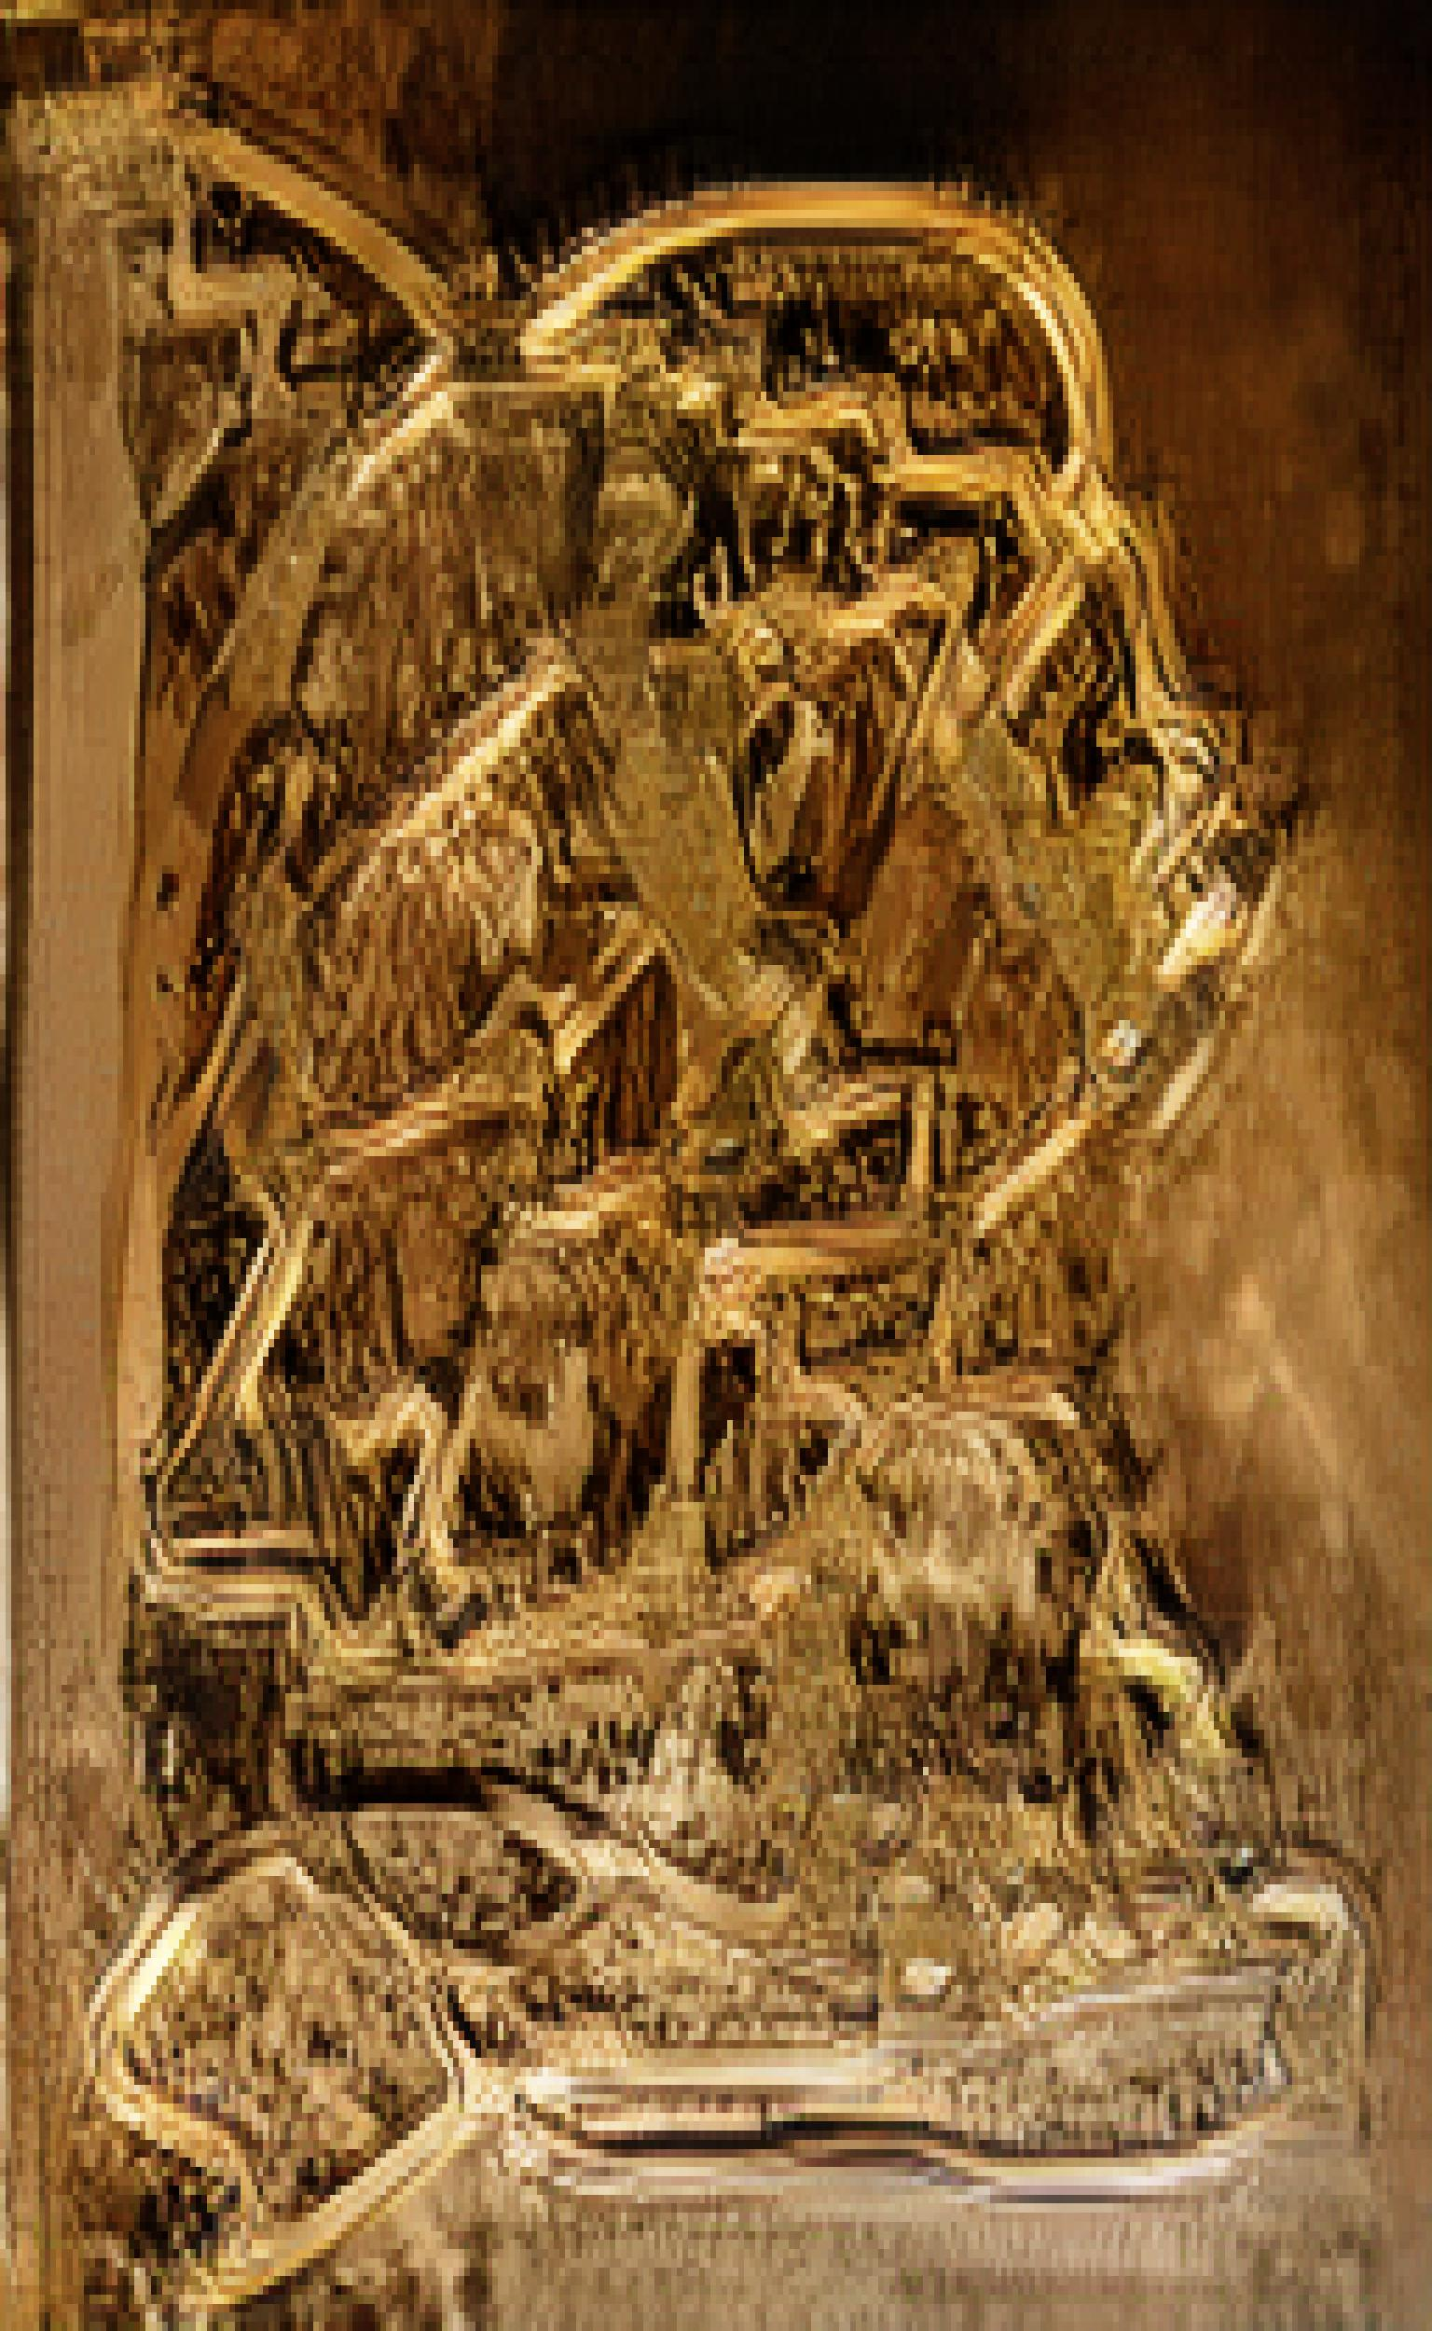
Invert + gaussian blur pre-processing

Slide 37
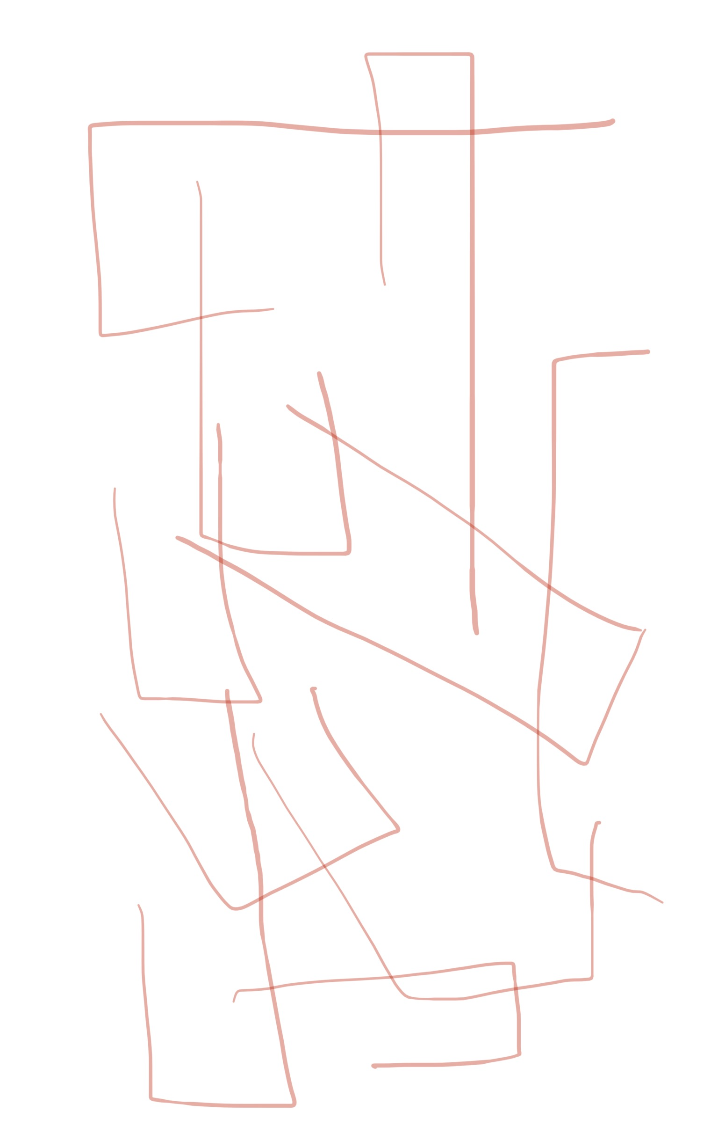
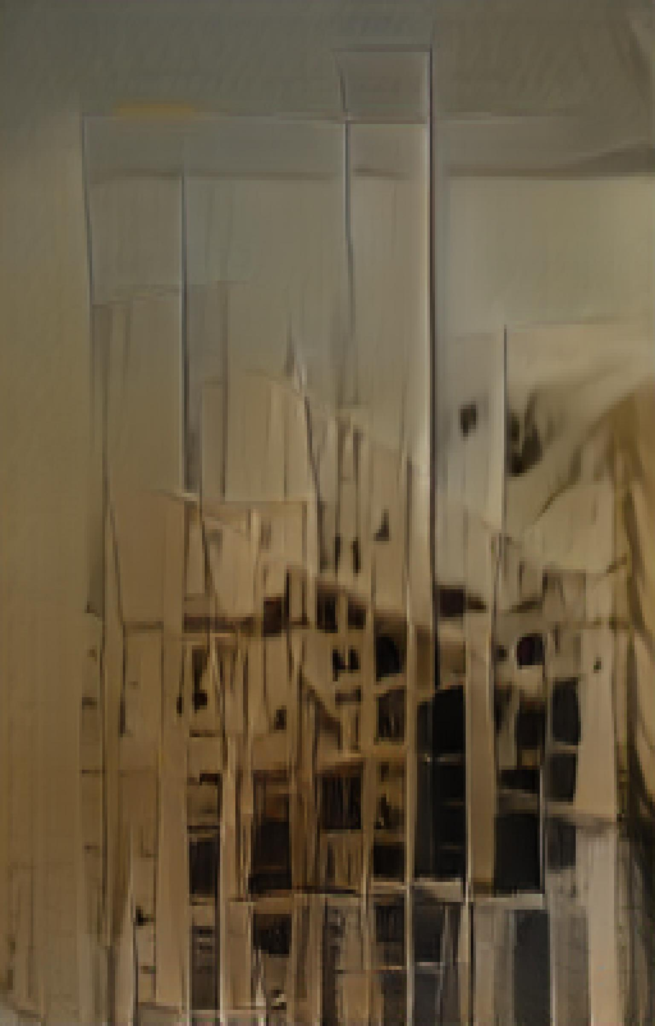
No pre-processing

Slide 38
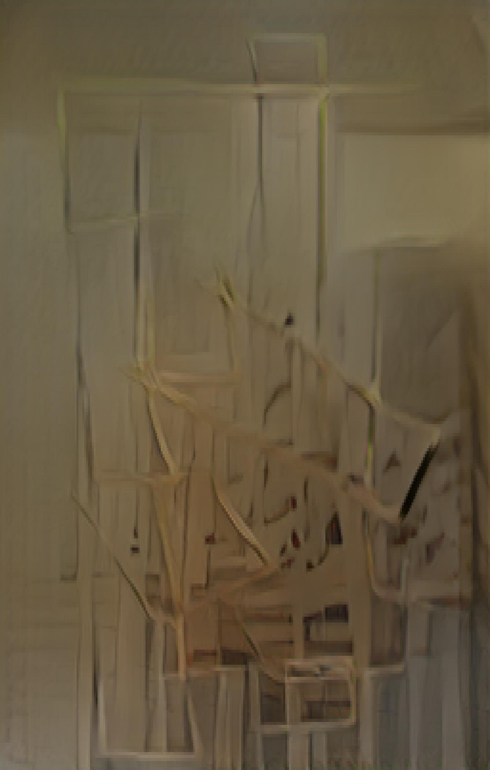
Gaussian blur pre-processing

Slide 39
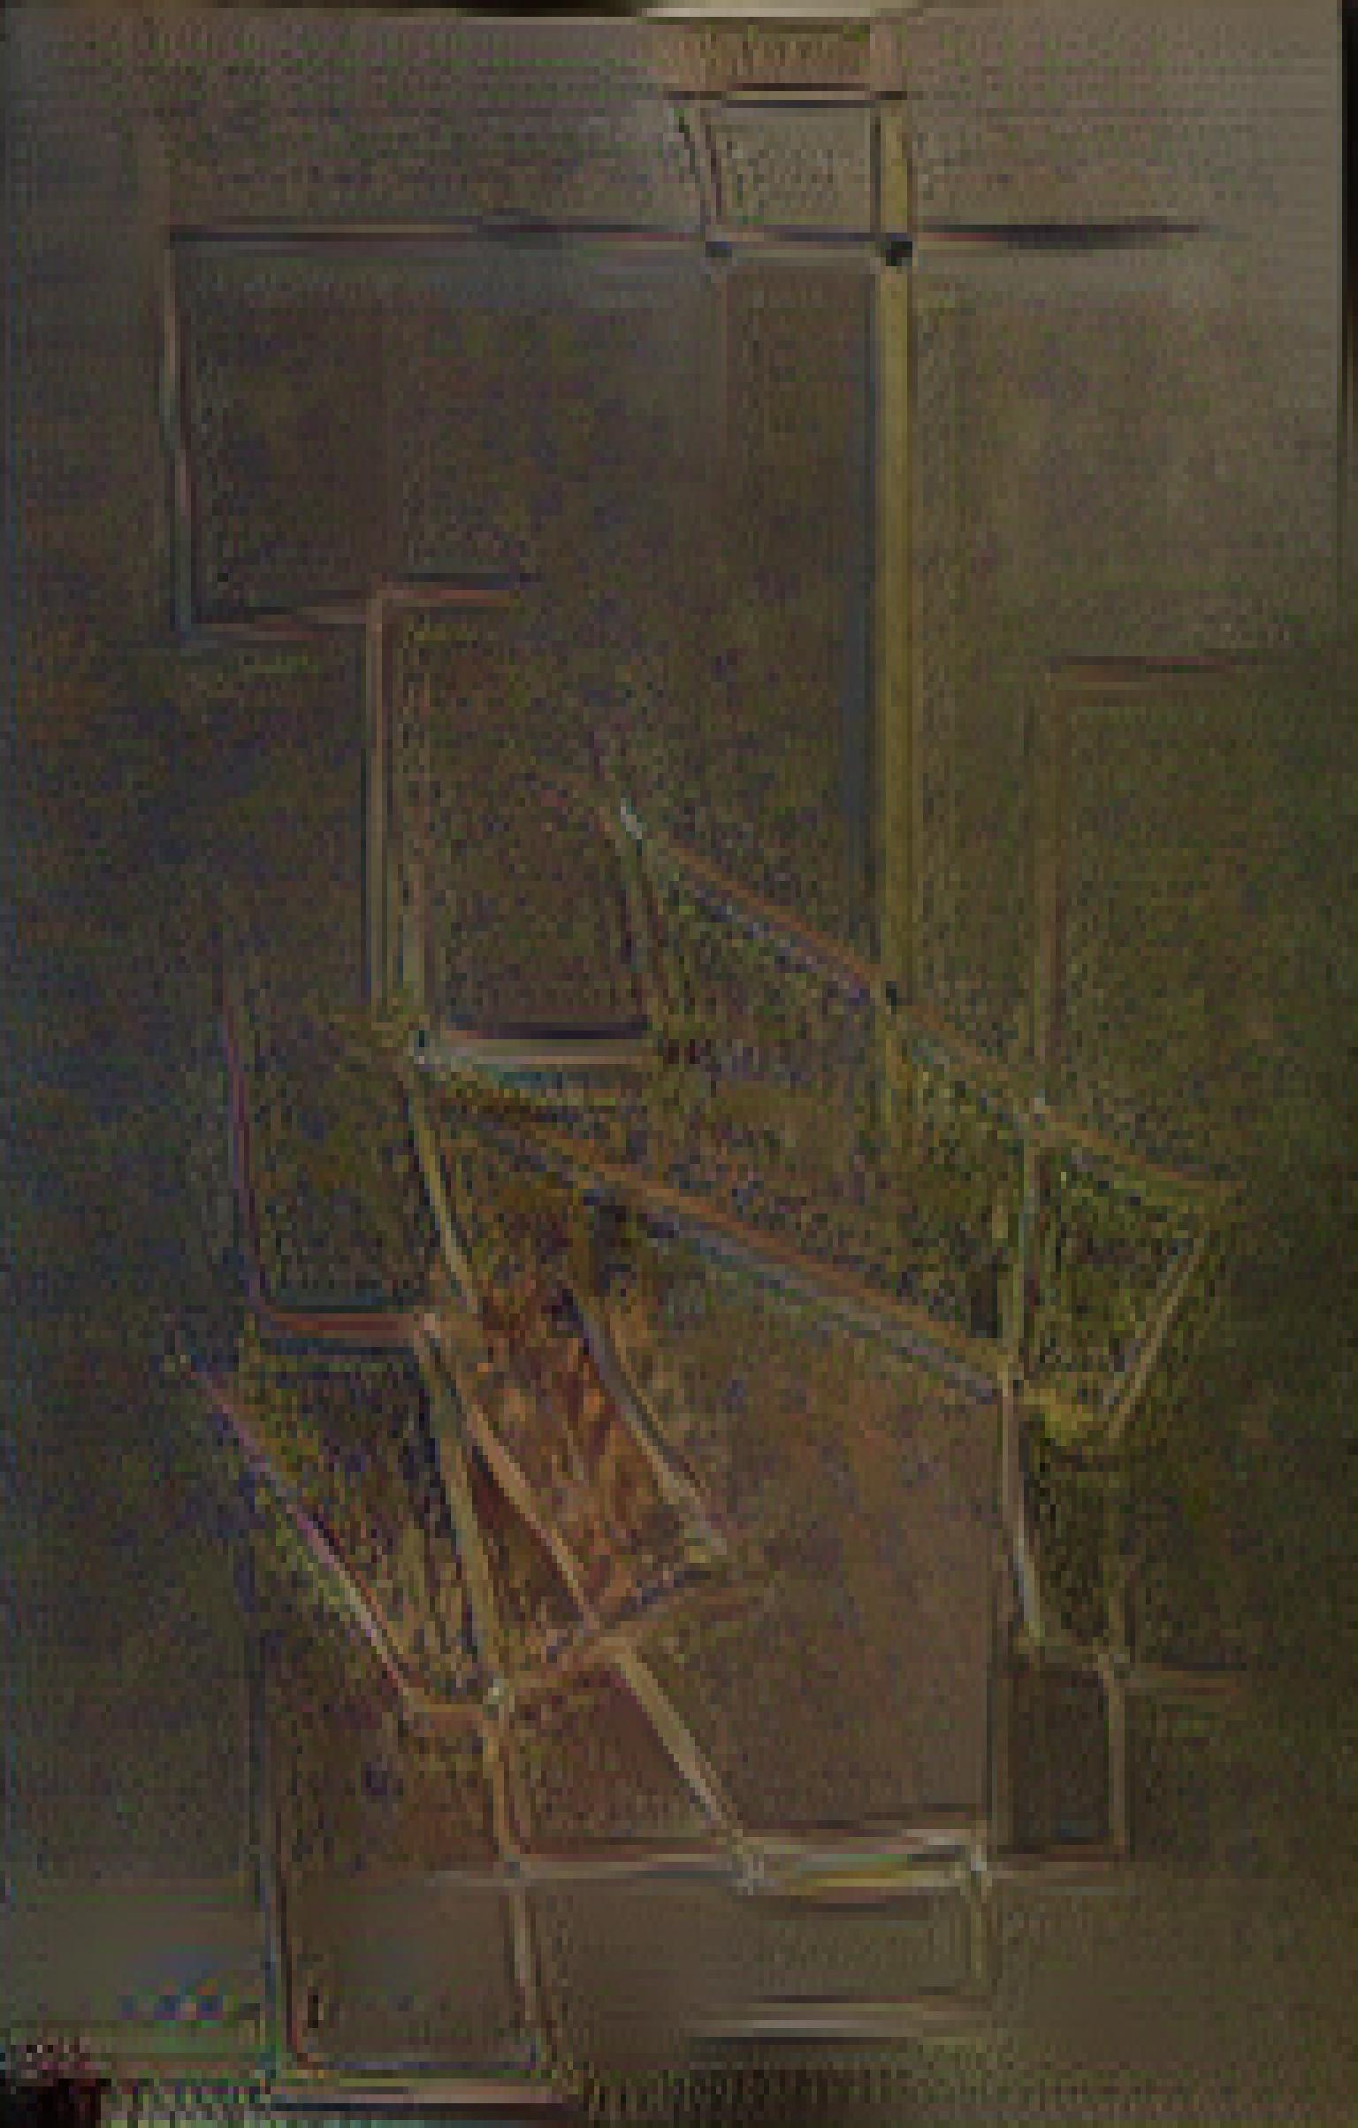
Invert + gaussian blur pre-processing

Slide 40
Plotter inputs

Slide 41
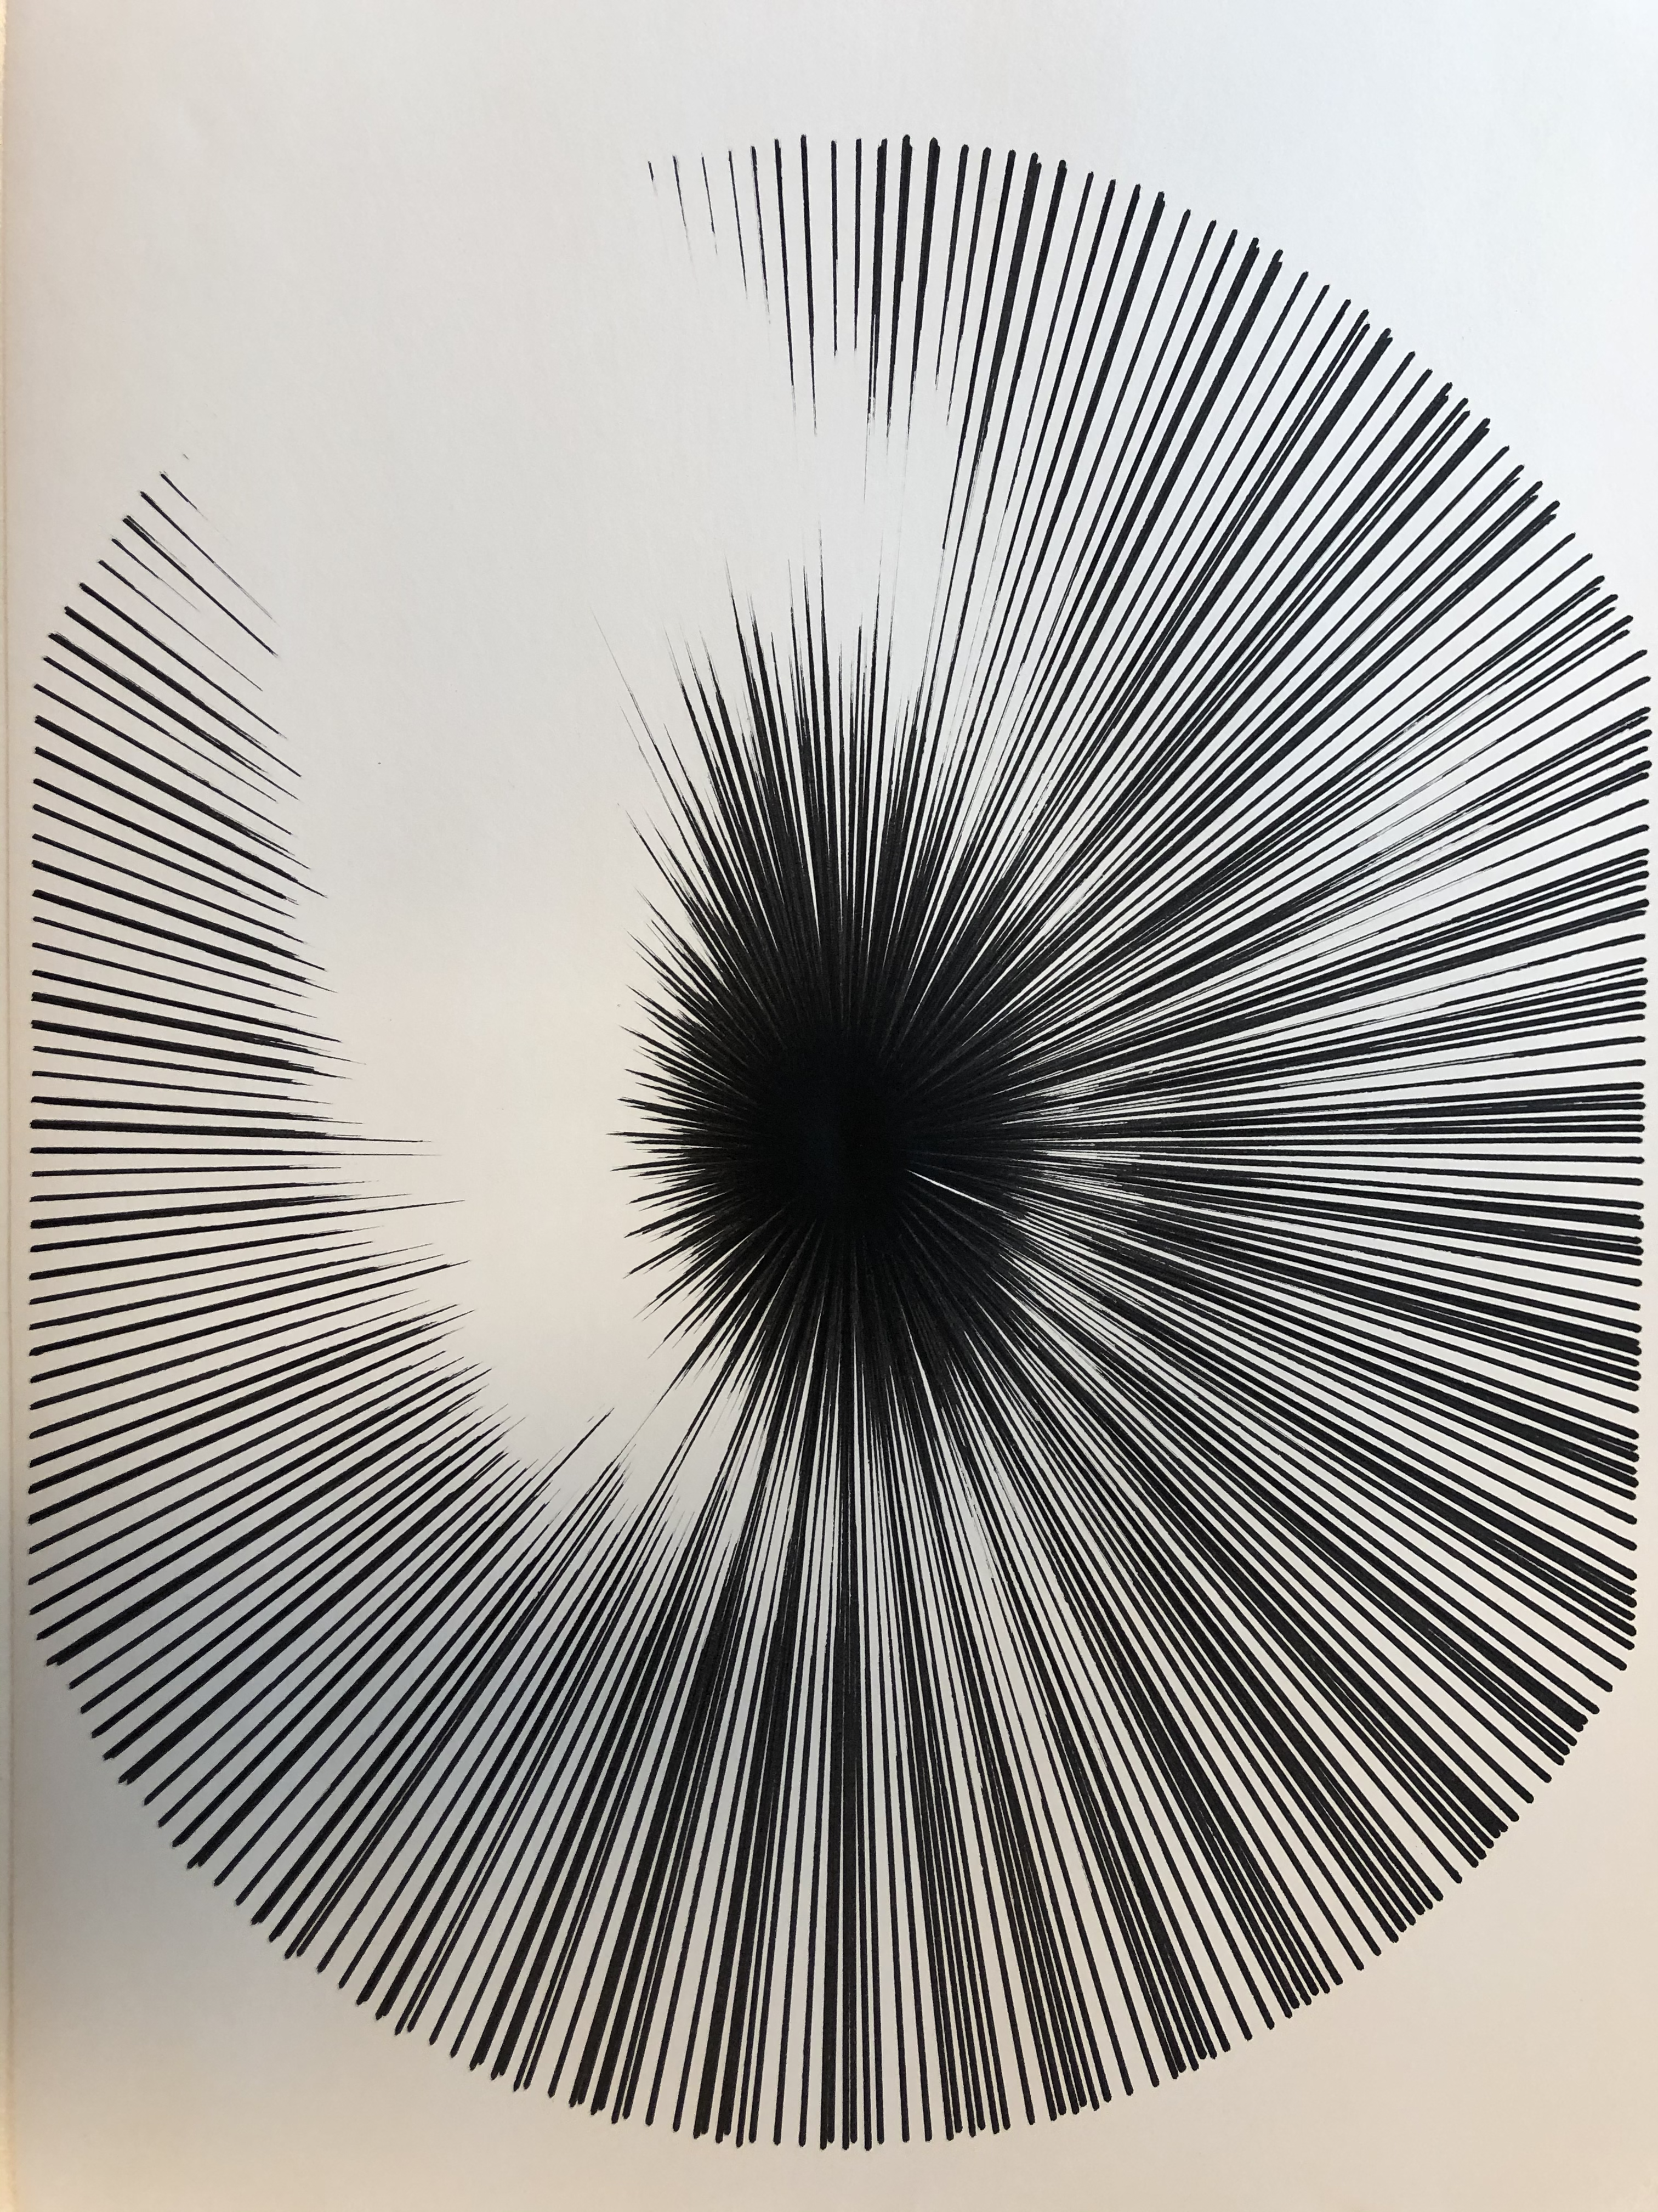
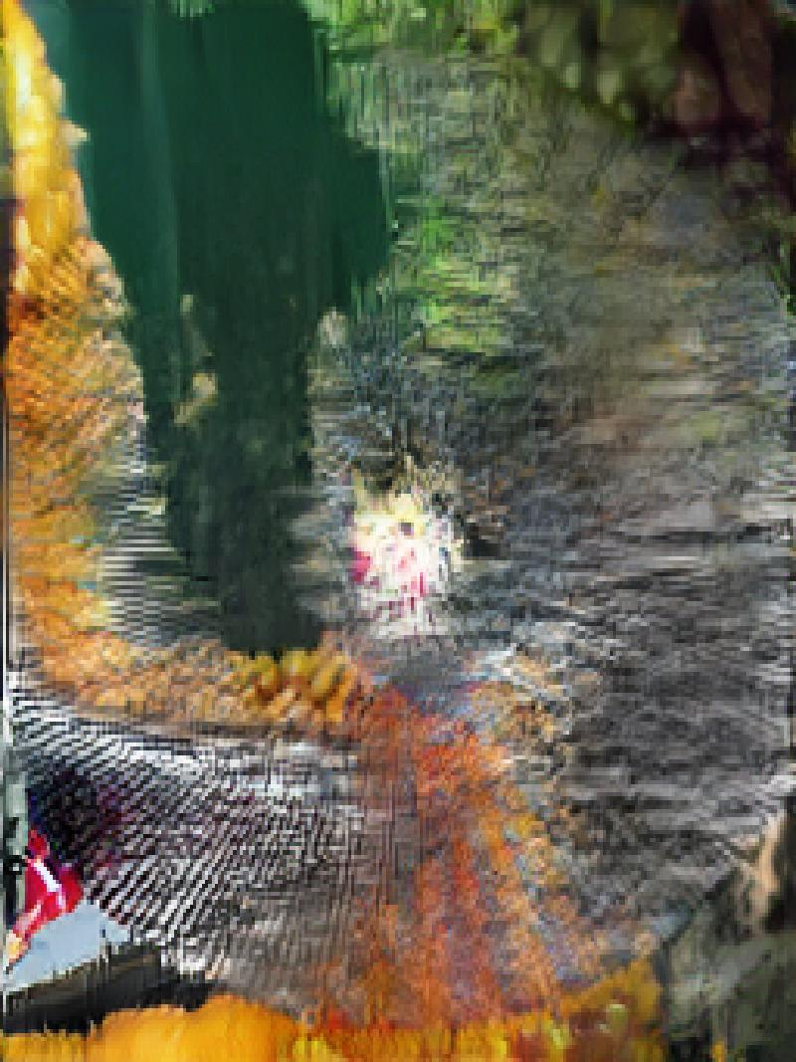
No pre-processing

Slide 42
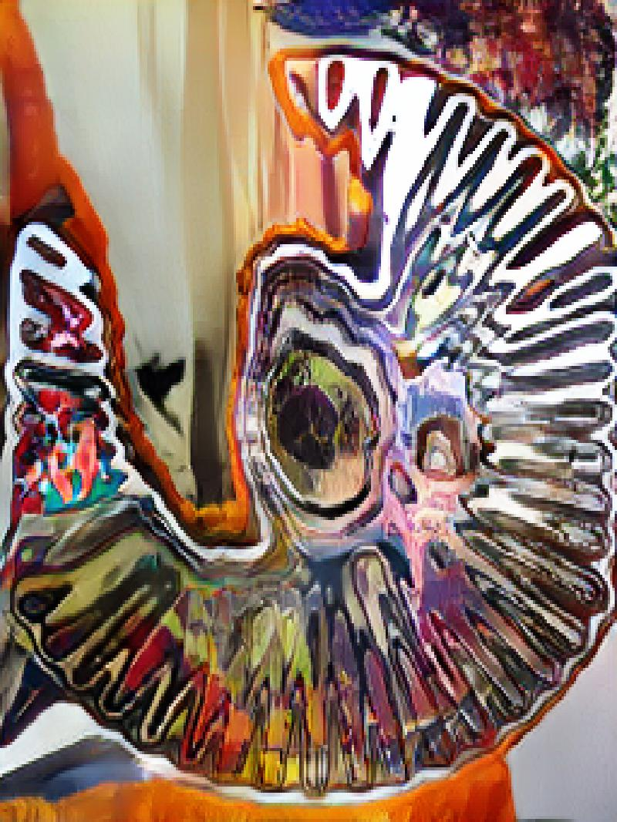
Gaussian blur pre-processing

Slide 43
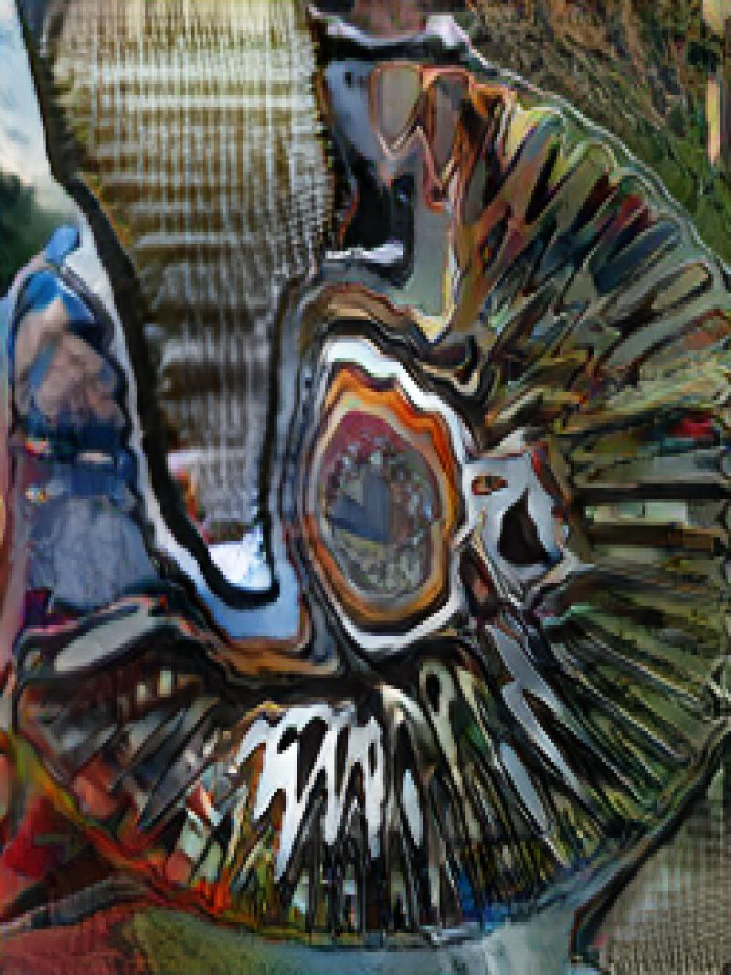
Invert + gaussian blur pre-processing

Slide 44
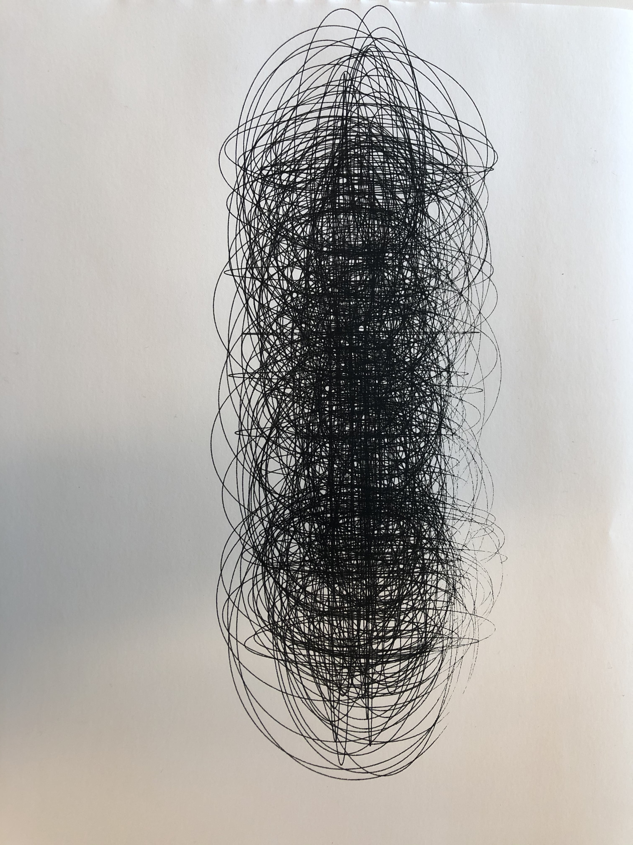

No pre-processing

Slide 45

Gaussian blur pre-processing

Slide 46

Invert + gaussian blur pre-processing

Slide 47
Digitally coded inputs

Slide 48


No pre-processing

Slide 49

Gaussian blur pre-processing

Slide 50

Invert + gaussian blur pre-processing

Slide 51


No pre-processing

Slide 52

Gaussian blur pre-processing

Slide 53

Invert + gaussian blur pre-processing

Slide 54


No pre-processing

Slide 55

Gaussian blur pre-processing

Slide 56

Invert + gaussian blur pre-processing

Slide 57


No pre-processing

Slide 58

Gaussian blur pre-processing

Slide 59

Gaussian blur extra pre-processing

Slide 60

Gaussian blur extra pre-processing

Slide 61


No pre-processing

Slide 62

Gaussian blur pre-processing

Slide 63

Invert + gaussian blur pre-processing

Slide 64


No pre-processing

Slide 65

Gaussian blur pre-processing

Slide 66

Invert + gaussian blur pre-processing

Slide 67


No pre-processing

Slide 68

Gaussian blur pre-processing

Slide 69

Invert + gaussian blur pre-processing

Slide 70
Conclusions!
SPADE-COCO is made for abstract shapes, but!
Can still feed abstract shape input that makes the results “non-sensical” for what it was built for (instead, more of an aesthetic/design output)
Line-work (esp. mark-making) confuses the system (which makes sense, the GAN probably works with shape detection)
Gaussian blur:
Sometimes brings out input drawing more in output
Yields some very interesting results

